Slide 1
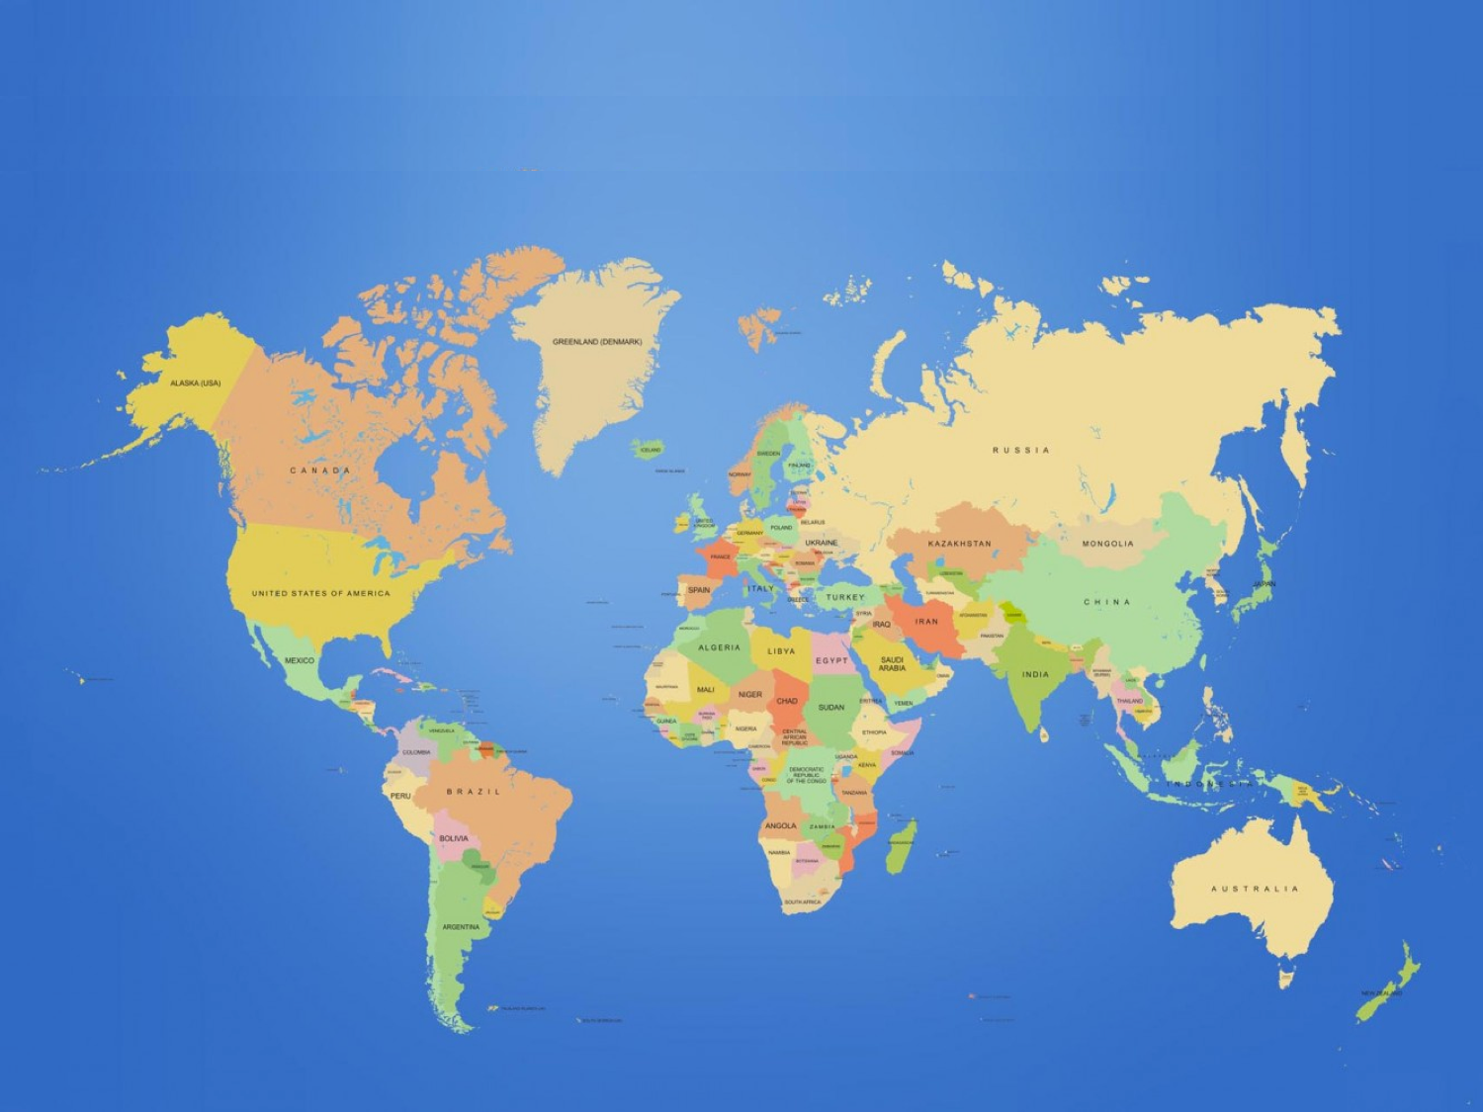
Farming Around the World

Slide 2
Do farms vary throughout the world?

Slide 3
What factors affect a country’s ability to produce their own food?
How does the equator affect climate?
Climate

Slide 4
What factors affect a country’s ability to produce their own food?
Bananas grow in hot, humid, tropical regions.
Caribbean & Latin America
Tropical portions of Africa
South Pacific
Equator
Climate

Slide 5
What factors affect a country’s ability to produce their own food?
Washington
China
Apples grow best in climates with cold winters
Turkey
Equator
Climate

Slide 6
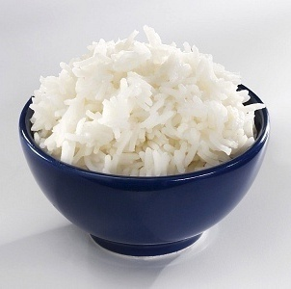
What factors affect a country’s ability to produce their own food?
China
Rice grows in temperatures from 63°-97° F
India
Equator
Indonesia
Climate

Slide 7
What factors affect a country’s ability to produce their own food?
All fruits, vegetables, and grains have specific climate requirements for growth.
Equator
Climate

Slide 8
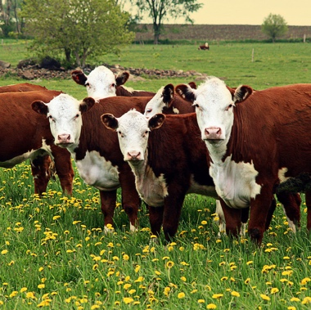
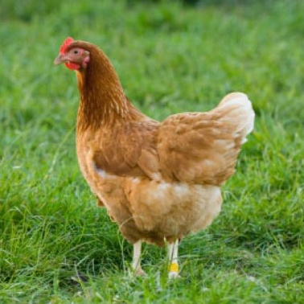
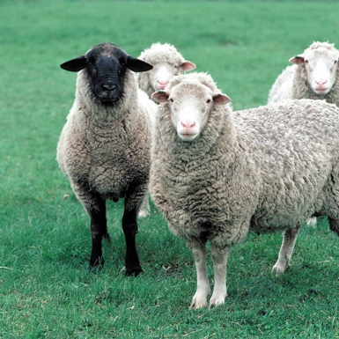
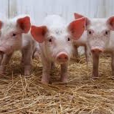
What factors affect a country’s ability to produce their own food?
Livestock raised for food can live in many climates.
Some breeds and species thrive better than others in extreme hot or cold
Very cold climates may require additional housing
Equator
Climate

Slide 9
What factors affect a country’s ability to produce their own food?
Space NOT occupied by:
People
Buildings
Lakes, rivers, or streams
Open Space

Slide 10
What factors affect a country’s ability to produce their own food?
Larger animals require more space
Some animals eat grass
Some animals eat grains that also require space to be grown
Open Space

Slide 11
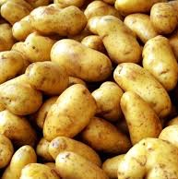
What factors affect a country’s ability to produce their own food?
25,000-35,000 lbs. of potatoes can be harvested from 1 acre
160 bushels of corn can be grown on 1 acre
56 bushels of wheat can be grown on 1 acre
(2300 lbs. of white flour)
Open Space

Slide 12
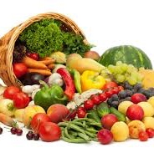
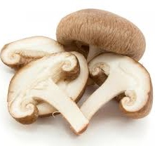
What factors affect a country’s ability to produce their own food?
Blueberries need acidic soil
Most garden produce prefers neutral soil
Mushrooms can grow in alkaline soil
What is the soil Ph?
Soil Quality

Slide 13
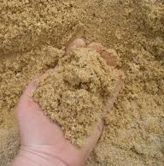
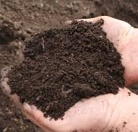
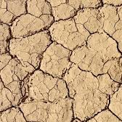
What factors affect a country’s ability to produce their own food?
Sandy soils have good drainage, but don’t hold moisture and nutrients well
Loam soil is ideal for many food crops
Clay soil lacks drainage
What is the soil texture?
Soil Quality

Slide 14
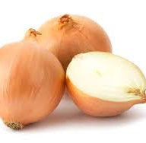
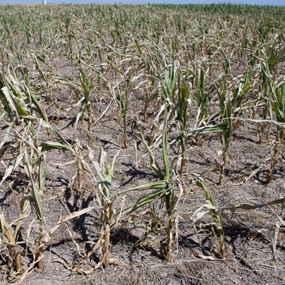
What factors affect a country’s ability to produce their own food?
Too much water can cause root crops to rot.
Drought decreases harvest or kills the crop
Too much, or too little is detrimental to crop growth
Water Availability

Slide 15
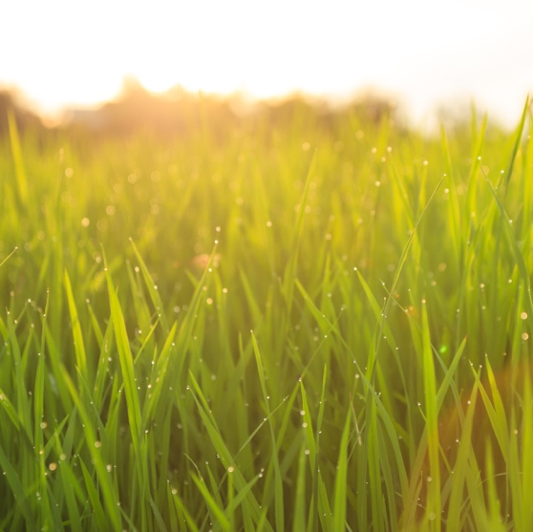
What factors affect a country’s ability to produce their own food?
Growing rice requires relatively high quantities of water
Growing sugar beets requires relatively low quantities of water
Too much, or too little is detrimental to crop growth
Water Availability

Slide 16
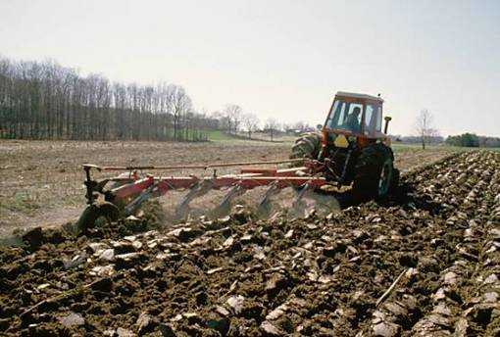
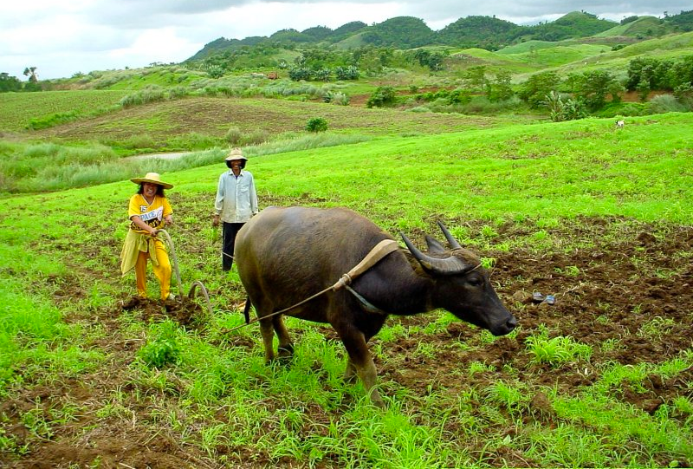
What factors affect a country’s ability to produce their own food?
How are fields plowed?
Available Technology

Slide 17
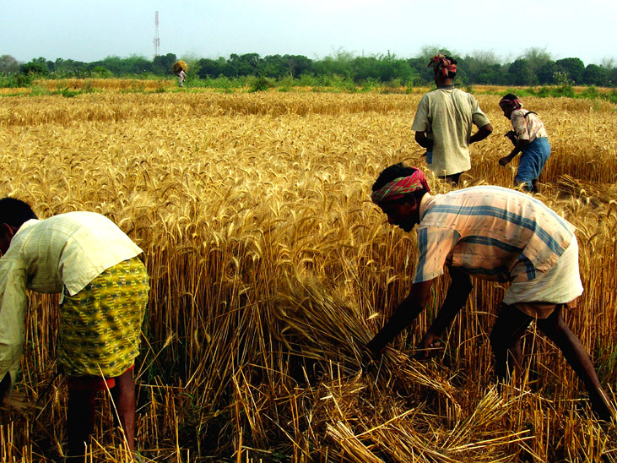
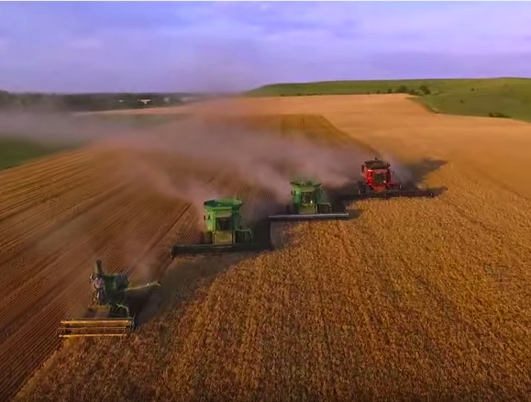
What factors affect a country’s ability to produce their own food?
How are crops harvested?
Available Technology

Slide 18
What factors affect a country’s ability to produce their own food?
Capitalism
Socialism
What form of government is there?
Economics & Government

Slide 19
What factors affect a country’s ability to produce their own food?
Animal husbandry practices
Use of specific seed varieties such as hybrids, GMOs, and heirloom
Fertilizer and pesticide use
Animal waste management
Does the government regulate farm practices?
Economics & Government

Slide 20
What factors affect a country’s ability to produce their own food?
In some cases, the government offers money to supplement farmers:
When market prices are too low
This can help manage supply and demand
To meet demands of new government regulations
If a new regulation for farm waste management is put in place, they might also offer money to farmers to help offset the cost of implementing the new regulation.
Are government subsidies offered?
Economics & Government

