Slide 1
Tree Care:
Solutions to Issues

Slide 2
Which is more appealing if you wanted to have visitors? A messy room or a clean room?

Slide 3
Which field would you rather walk through? The mowed field in the foreground or the unmowed field in the back?

Slide 4
Why do farmers need to manage weeds?
Weeds can grow quickly and compete with young seedling trees for limited resources
moisture,
nutrients,
light, and
space.
Tall weeds provide habitat for wildlife that can then eat or damage the seedling trees
Tall weeds create a lot of biomass that can then burn in a wildfire. Tree needles destroyed by fire will never regrow and the tree can be permanently damaged.
Aesthetically, customers who visit tree farms like to see a well manicured landscape that is weed-free.
Customers who visit tree farms need to walk through the farm easily and unencumbered to find their preferred tree.

Slide 5
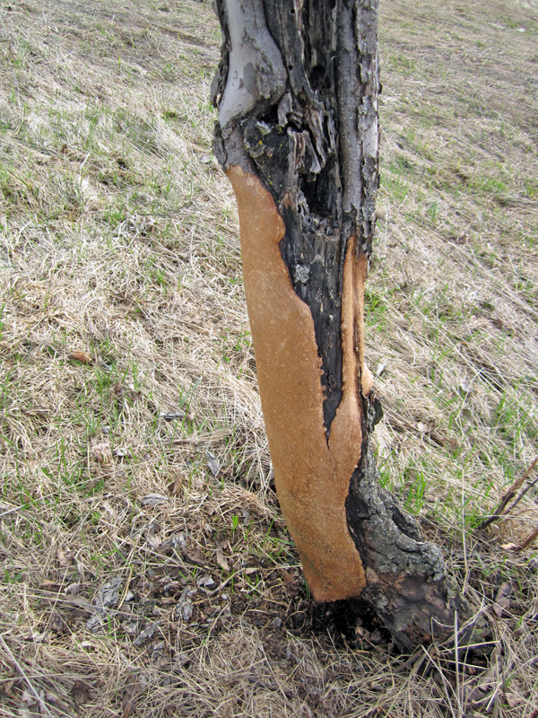
Wildlife can damage crops
Tall weeds provide habitat for wildlife that can then eat or damage the seedling trees
Girdling is usually the result of voles, also known as meadow mice, eating the bark at the base of a tree.
The layers of bark include the cambium which moves water and nutrients throughout the tree.
If the cambium is destroyed the tree will die since it can’t move water to the leaves and carbohydrates to the roots.
The severity of girdling usually increases with the amount of snow cover. The snow protects voles from predators and the elements.
PREVENTION OF GIRDLING:
Keep the area around trees free of tall grass or other places for voles to hide from predators in the summer will help to discourage population build up
Use mouse traps
Install physical barriers (plastic sleeves) around the base of trees

Slide 6
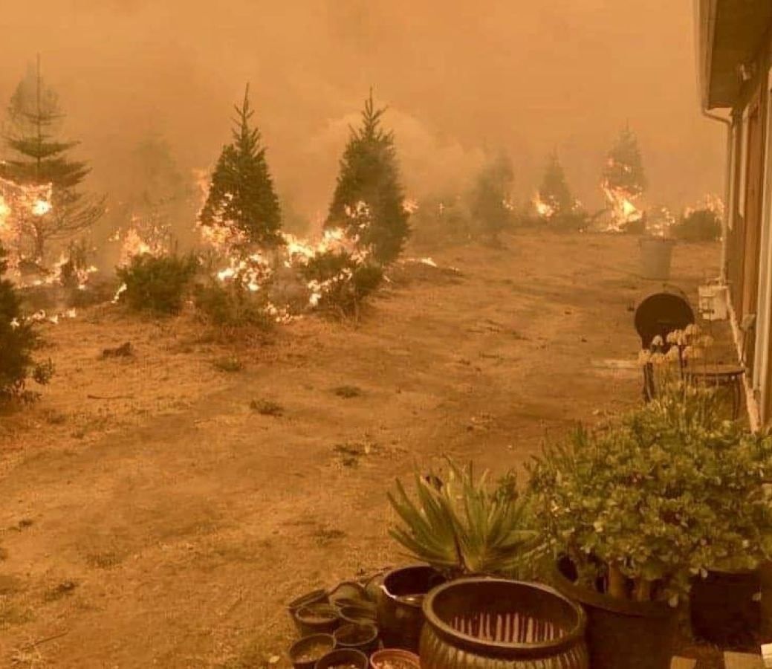
Fire can damage tree crops
Tall weeds create a lot of biomass that can then burn in a wildfire. Tree needles destroyed by fire will never regrow and the tree can be permanently damaged.
as the percent of crown scorch increases, mortality increases.
as the thickness of the bark decreases, mortality increases.
as the size of the trunk increases, mortality decreases.
PREVENTION OF FIRE
Mow tall grass and weeds around trees to reduce biomass available
If low grass does burn, it shouldn’t reach the tree needles
If low grass does burn, it shouldn’t burn hot enough to damage the bark if the tree is healthy

Slide 7
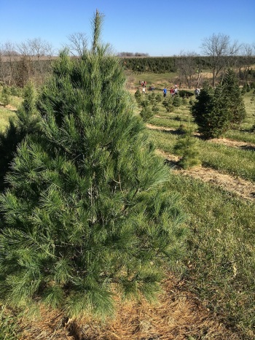
Farms need to look nice
Aesthetically, customers who visit tree farms like to see a well manicured landscape that is weed-free.
Customers who visit tree farms need to walk through the farm easily and unencumbered to find their preferred tree.
This is also a liability issue. If a customer gets hurt (slips, falls, etc.) it could be the farmer’s fault. Manicured walkways will minimize potential injuries.

Slide 8
Options for weed management
Mowing – cutting the weeds with a mower
Applying herbicides – nonselective herbicides should only be used as a last resort
Mulching – using wood chips or other mulching material around the base of the trees can prevent weeds from growing

Slide 9
Insects and diseases
https://youtu.be/SvQTXEv1cpM

Slide 10
Irrigation
https://youtu.be/xjhlRqsOnUs

