Slide 1
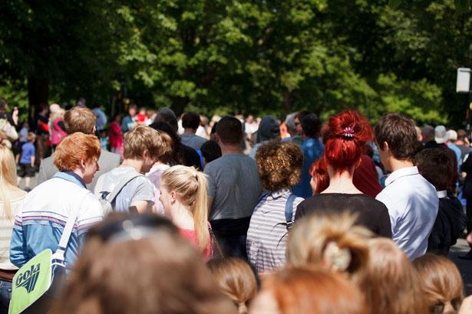
Today ------> 2050
8 billion 10 billion
Notes:
As an addition or to connect to the growing population, show students this image. Ask them how it makes them feel, what questions does it arise, what can they infer? Use these to prompt how to world hunger and food insecurity. Connect to arable land on earth, and that we can grow places we didn’t discuss before.

