Slide 1
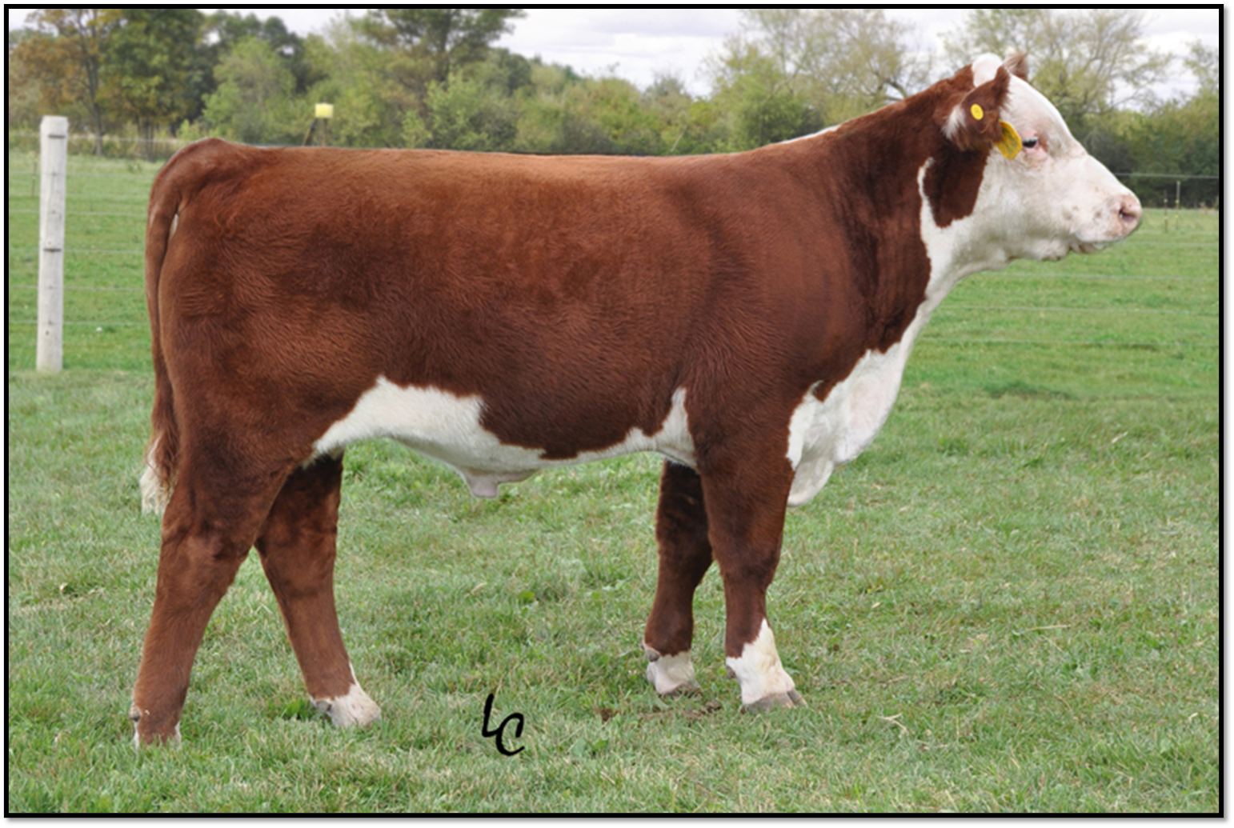
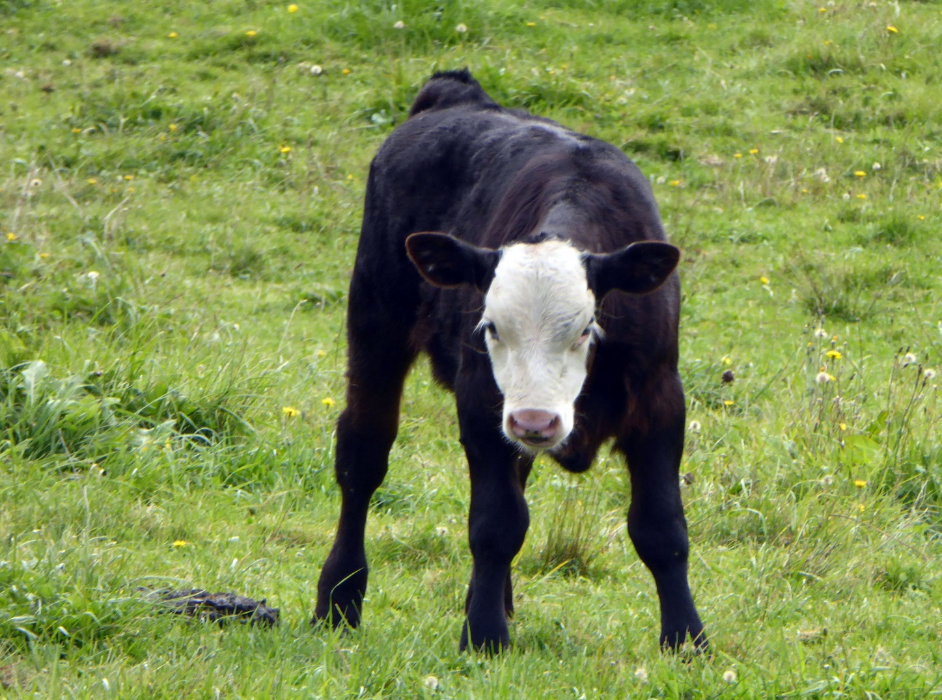
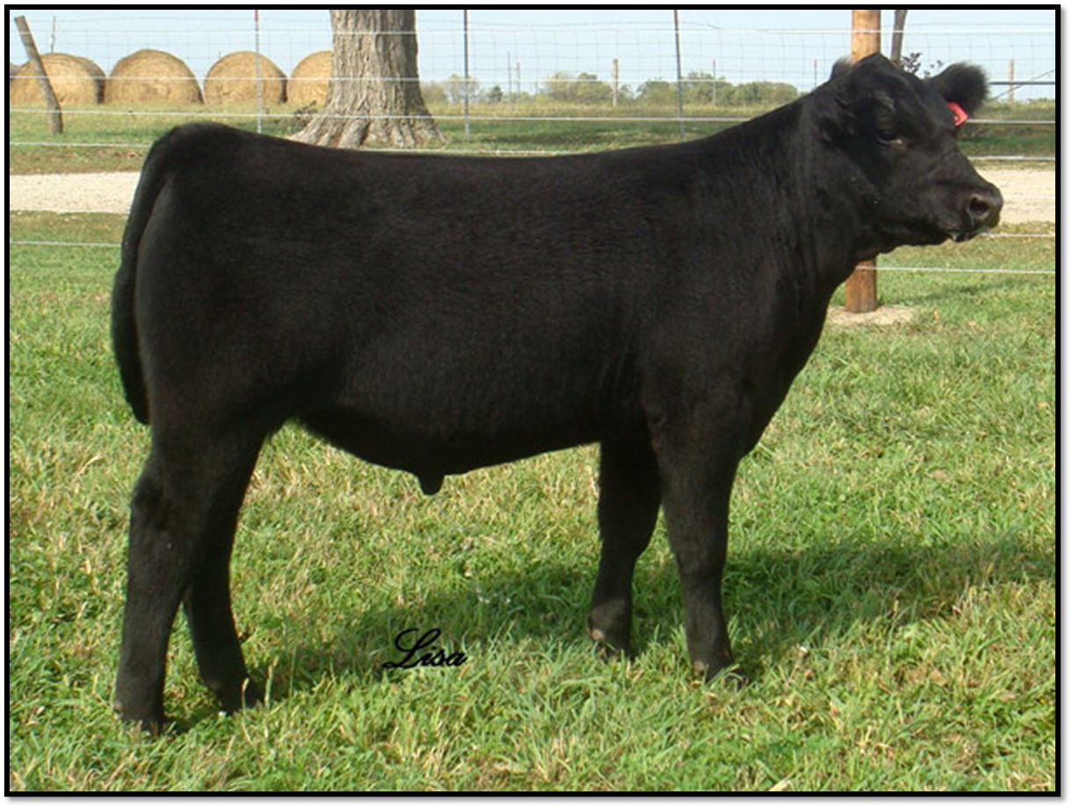
Hereford
Calf
Black Angus
Notes:
Show students the images of the cattle. Let them know that Hereford and Black Angus are breeds, or types of cattle. Ask students what they notice that is different about these two cows. Let students know that what they listed are called phenotypes, or traits of animal. Then let students know that farmers will often breed, or mate, these two breeds together to get traits they want. Ask students what traits a farmer may want in their cattle.
Click so that the calf image shows. Let students know that this is an image of a calf from the two parents. Pause and ask students what a calf is (young cow). Ask students what they notice that is similar between the calf and the Hereford parent, repeat for the Black Angus. Let students know that today they are going to investigate this further.

