Slide 1
Title
Tree Care at Home

Slide 2
Would You Rather?
Go to one side of the room for option 1 and the other side of the room for option 2

Slide 3
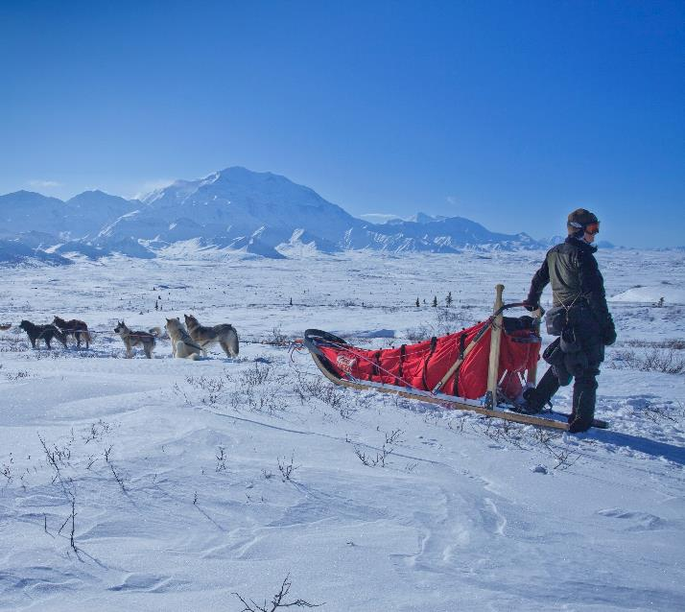
Would You Rather?

Slide 4
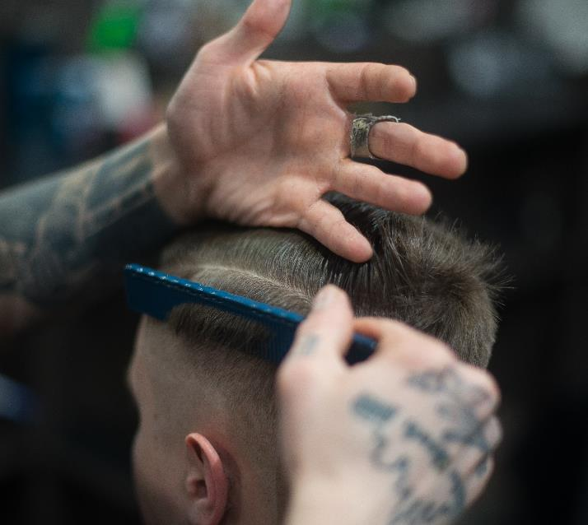
Would You Rather?

Slide 5
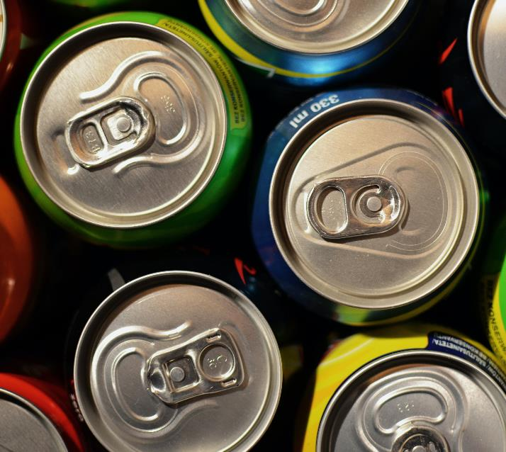
Would You Rather?

Slide 6
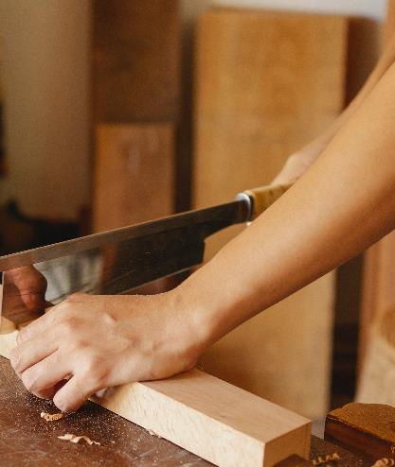
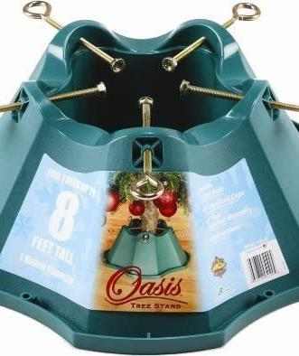
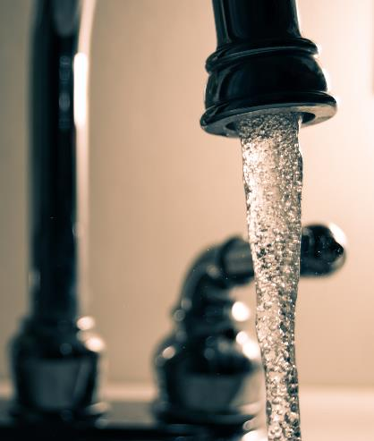
What materials do you need to keep your Christmas tree alive?
Notes:
Photo by Ono Kosuki from Pexels, Photo by Steve Johnson from Pexels, Amazon.com: Handythings Christmas Tree Stand, for Trees Up to 8-Feet, 1.3-Gallon Water Capacity : Home & Kitchen

Slide 7
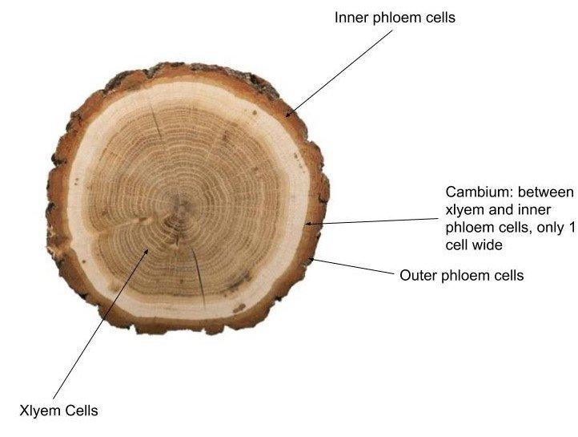
Inside vs Outside of a Christmas Tree
Notes:
https://www.ruralsprout.com/christmas-tree-last-longer/

Slide 8
An Inside Look
Notes:
xylem and phloem | Biology lessons, Biology classroom, Plant science (pinterest.com)

Slide 9
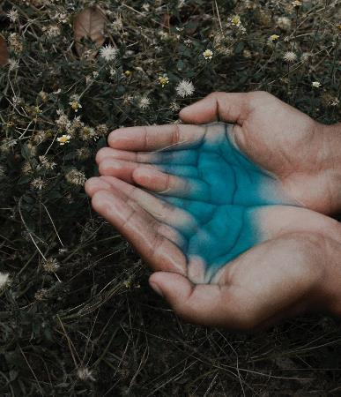
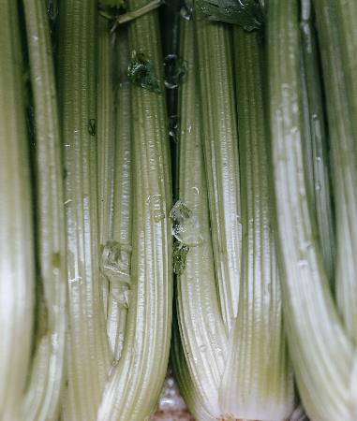
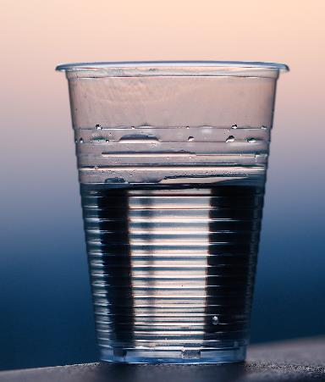
Celery Experiment
Notes:
Photo by Michael Burrows from Pexels, Photo by Meir Roth from Pexels, Photo by Oscar Alvarado from Pexels

Slide 10
Title
DAY 2
Tree Care at Home

Slide 11
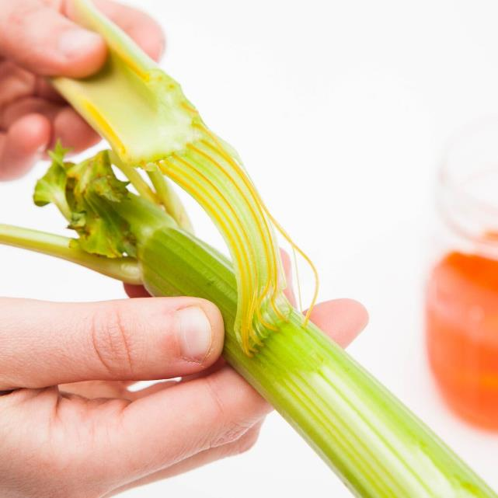
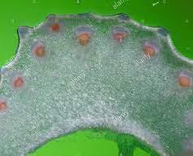
Results
xylem
phloem
Notes:
https://www.pinterest.com/pin/29273466305977470/, St. Paul Lutheran Church - Holy Week and Easter Activities (stpaulottawa.org)

Slide 12
Thank You
More Resources:
Lessons
Links
Contact

