Slide 1
Pine Tree
Ridged clusters of needles for leaves
Cones with seeds for reproduction that are tight to the branch
Grown for timber, wood, and Christmas trees
Keeps its needles year round

Slide 2
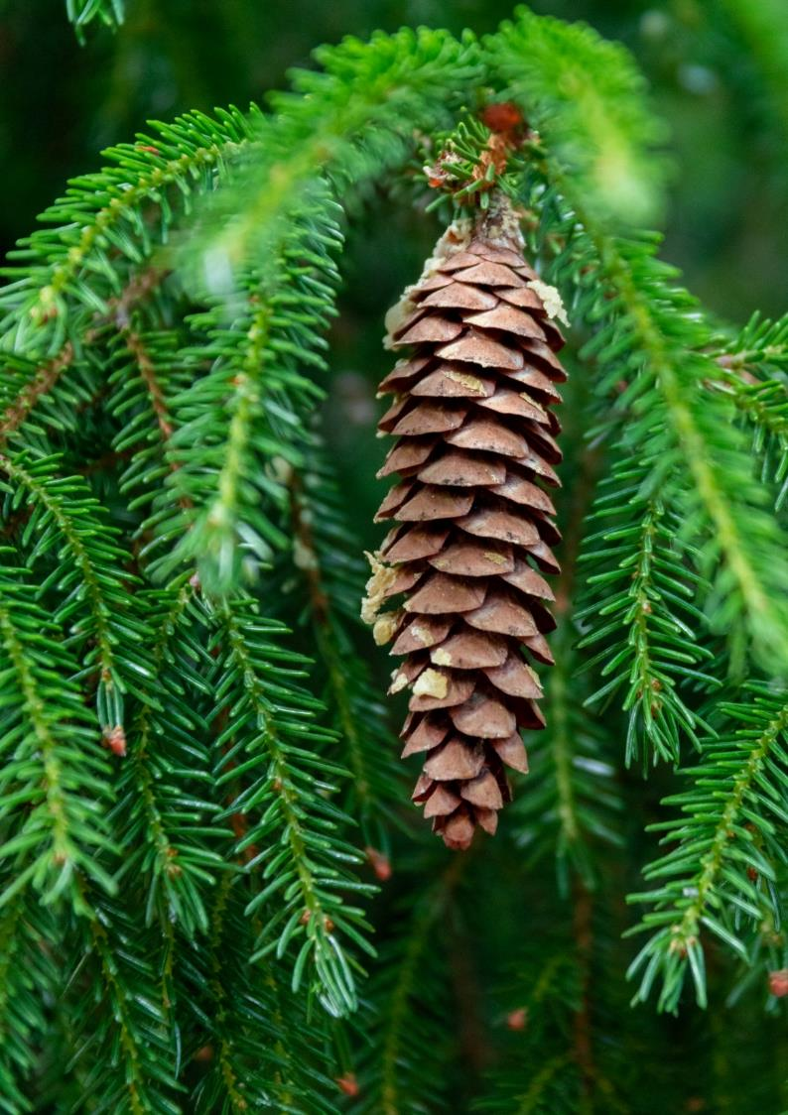
Spruce
Has hanging pinecones
The tree grows in a cone shape
Grown for timber, wood, and Christmas trees
Keeps its needles all year round

Slide 3
Fir
Has upright cones
Flat needle like leaves
Grown for timber, wood, and Christmas trees
Keeps needle leaves all year around

