Slide 1
Scroll through the pages. Count how often you see a truck driver.

Slide 2
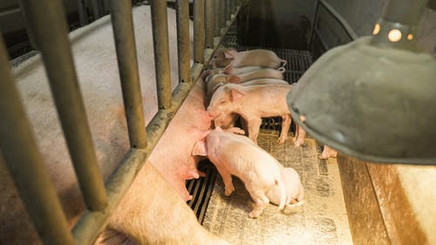
Piglets stay in Farrowing Crates until they are 21 days old.

Slide 3
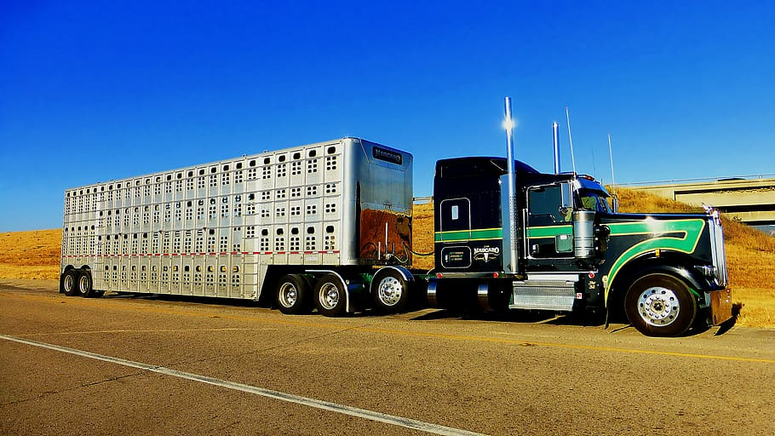
Piglets are then weaned from their mothers and taken to a nursery.

Slide 4
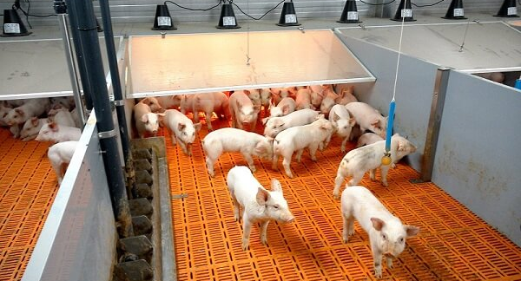
Piglets are here for anywhere between 42 to 56 days.
Notes:
https://pig-farming.net/equipment/piglet-nursery-crate/

Slide 5
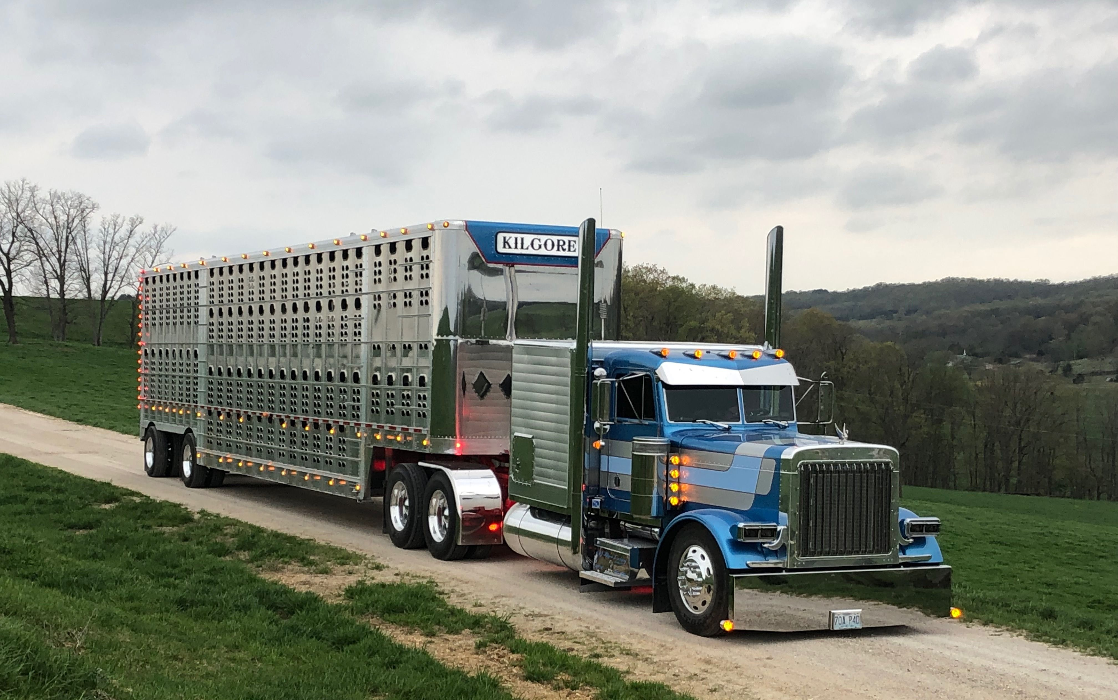
Pigs are then transported from the nursery to the finisher building.
Notes:
https://www.pinterest.com/pin/433401164140109238/

Slide 6
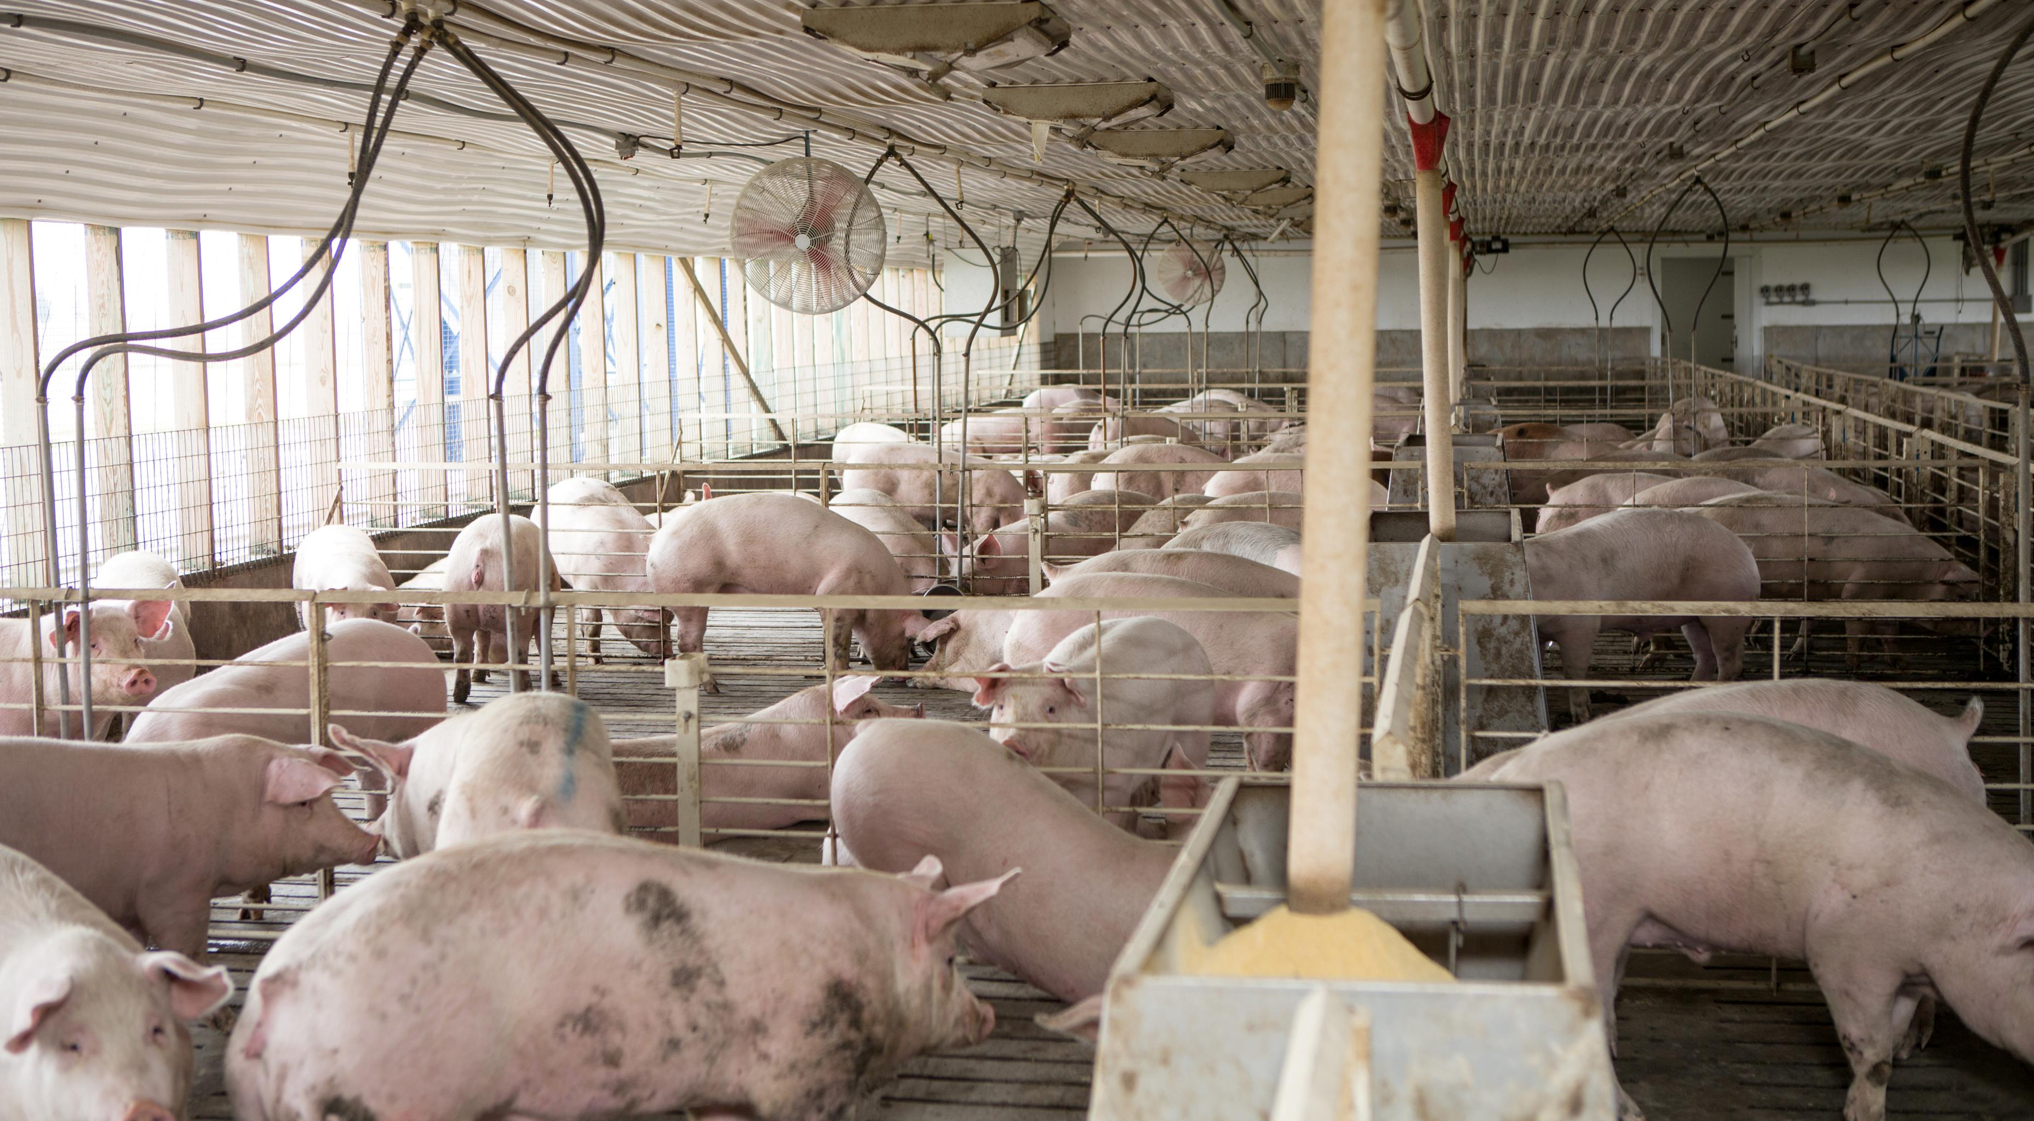
Pigs complete their growing, which takes between 115 to 120 days.

Slide 7
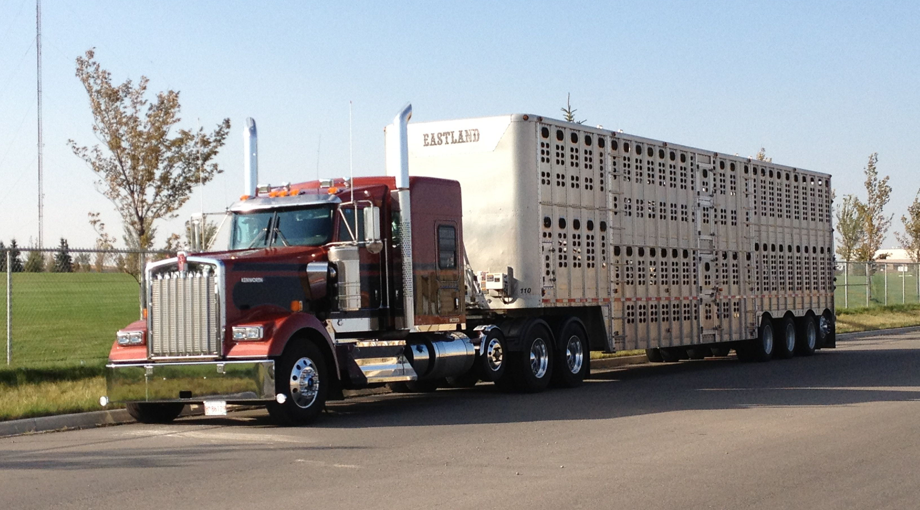
Pigs are transported to a meat processing facility.
Notes:
https://www.pinterest.com/pin/293367363197486518/

Slide 8
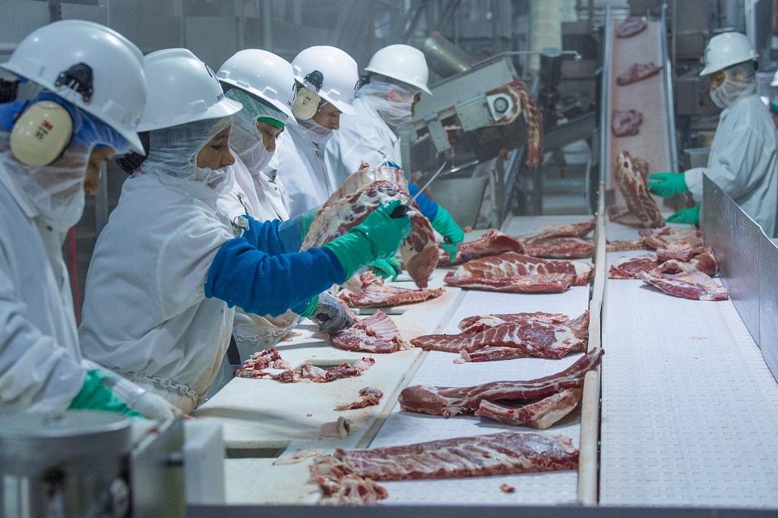
Pigs are harvested and processed for consumption.
Notes:
https://thecounter.org/usda-final-approval-faster-hog-line-speeds-pork-processing/

Slide 9
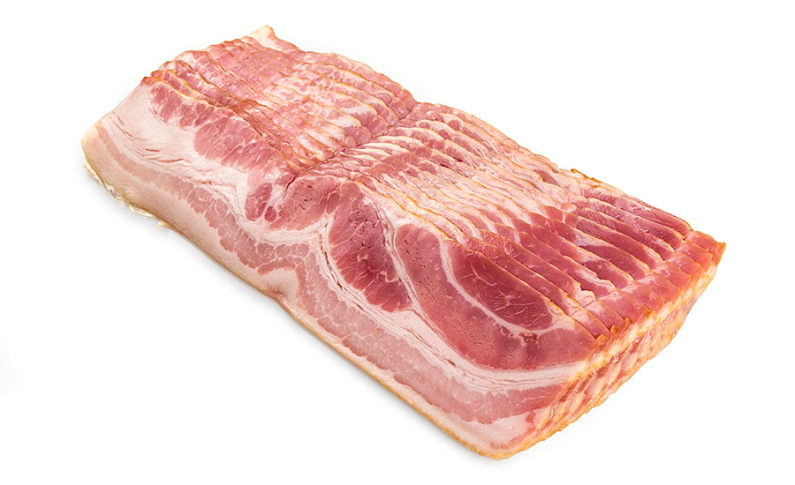
The pork is put into packaging.

Slide 10
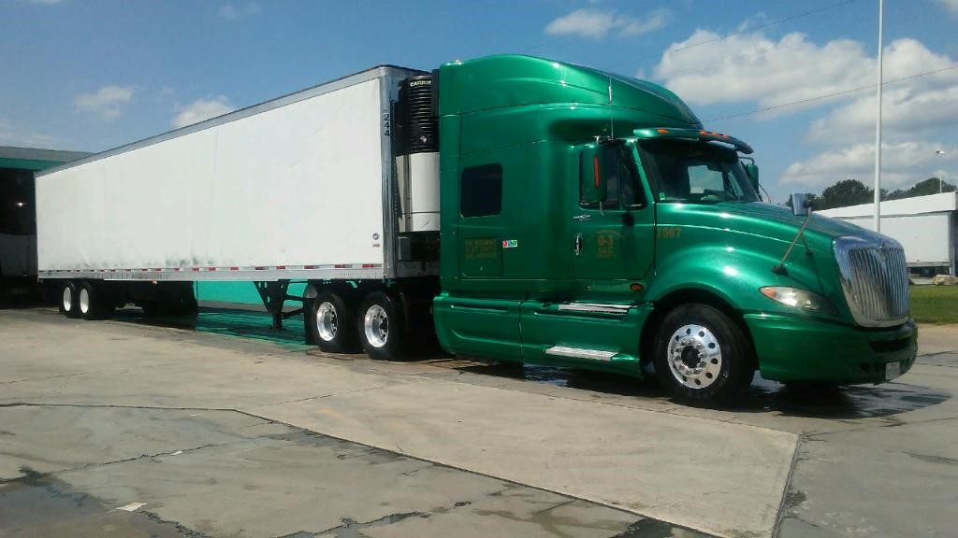
The pork products are transported in a refrigerated truck to their retail locations.

Slide 11
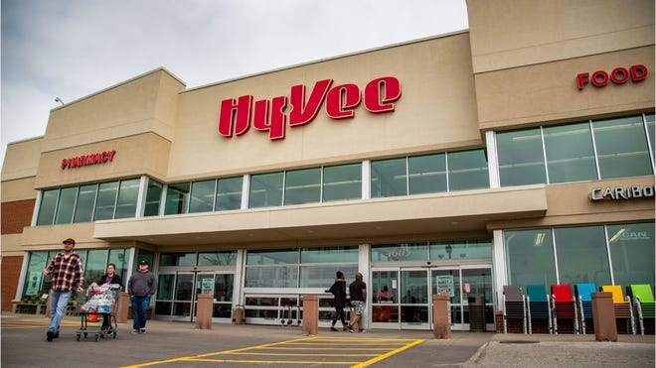
Consumers like you and I travel to the store where we purchase those pork products.

Slide 12
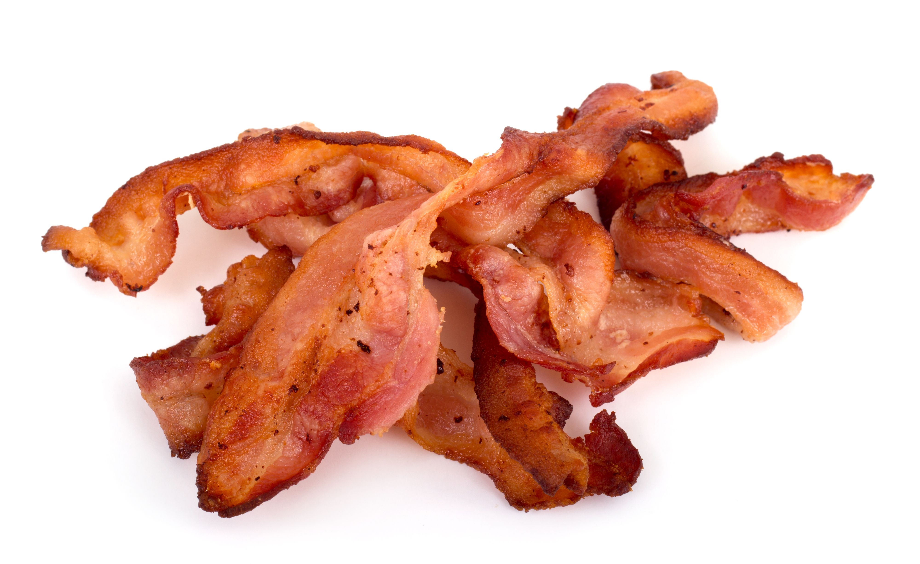
Finally, you have bacon!

Slide 13
How many times did you see a truck driver? What types of trailers were used? What did the truck driver transport? How important do you think truck drivers are for pork production?
Think & Discuss

