Slide 1
Lavender: Here, There, & Everywhere!
Find out where lavender grows!

Slide 2
Lavender: Here
Lavender is a specialty crop in Iowa
Not many farmers grow it, but it does grow well in Western Iowa, in the Loess Hills region.
Let’s meet one farmer who grows it!

Slide 3
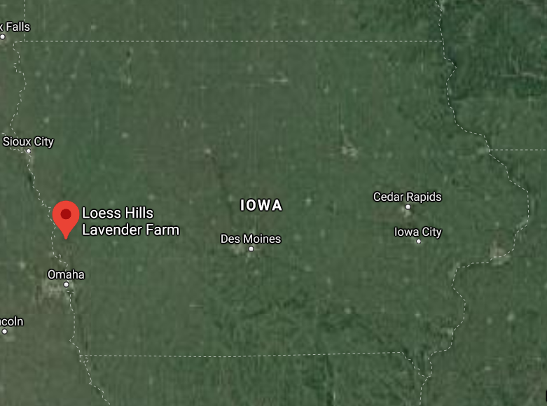
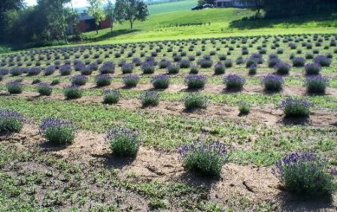
Loess Hills Lavender Farm

Slide 4
Lavender: There
Lavender is grown around the United States! Let’s look at a plant hardiness map
We can use the plant hardiness map to see where lavender survives.
Lavender can survive in hardiness zones from 5-9, depending on what type it is.

Slide 5
Plant Hardiness Map
Notes:
Students, this map shows us where different kinds of plants can grow. The key on the right shows us the “Average Annual Extreme Minimum Temperature.” The Fahrenheit temperatures are on the right of the key and the Celsius temperatures are on the right. This is a map put out by the United States Department of Agriculture. This map can tell us where plants can survive based on temperatures.
*Point out that the colors grow warmer (from purple to yellow) from the Northern part of the United States to the Southern part, and that different plants survive well in some climates compared to others. The Fahrenheit temperatures are on the right of the key and the Celsius temperatures are on the right.
Ask Students: Can someone find Iowa on the map? Which zones are in Iowa? (4a, 5b, and 5a). What about other states? Does anyone know where Texas is on the map? Which zones are in Texas? (6b through 10a). What about Washington? Can you find which zones are in Washington? (5b, 6a, 7a, 7b, 8a, and 8b).

Slide 6
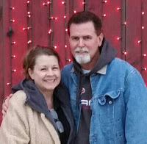
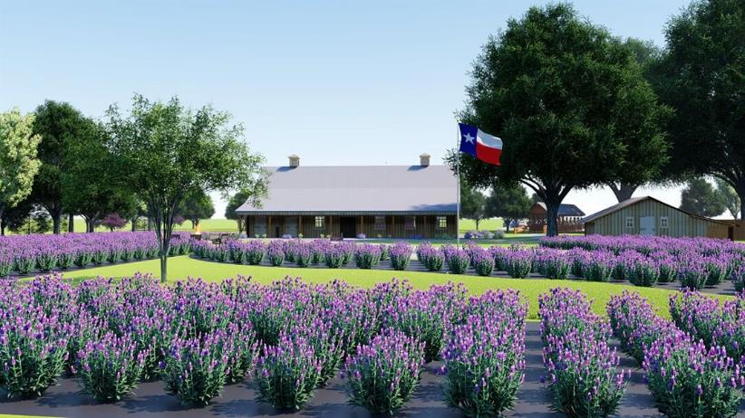
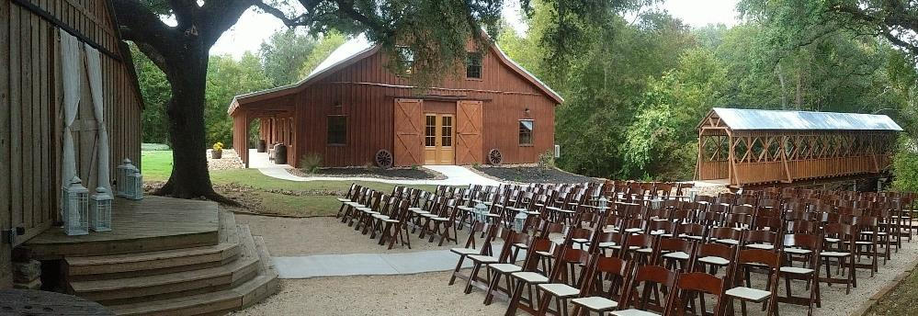
Let’s meet some farmers from across the United States Texas- Lacey Farms

Slide 7
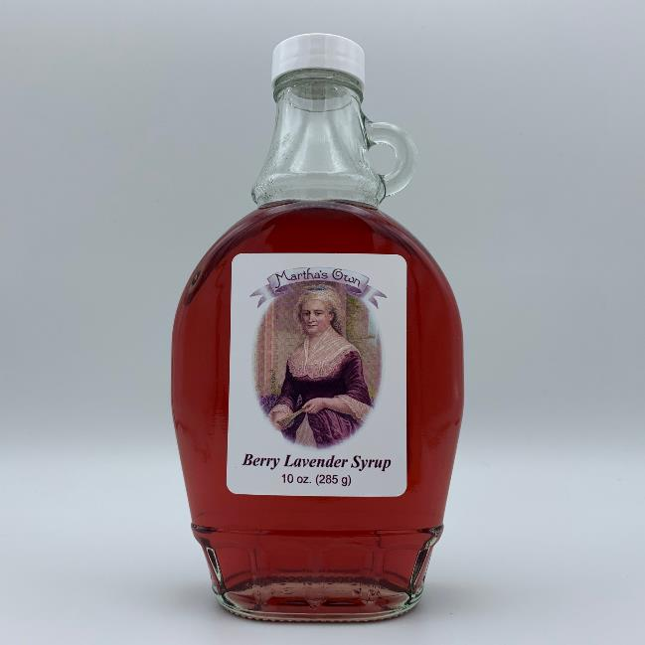
Washington- Washington Lavender

Slide 8
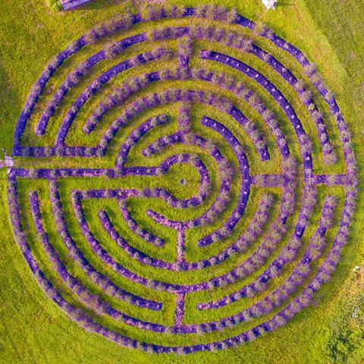
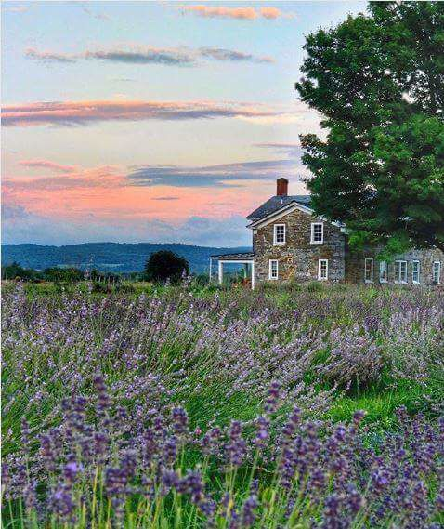
New York- Lavenlair Farm

Slide 9
Lavender: Everywhere
Lavender grows on farms all over the world. Let’s look at some of the countries that grow lavender!

Slide 10
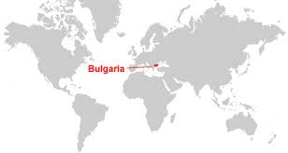
Bulgaria

Slide 11
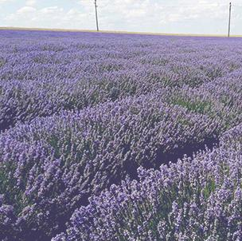
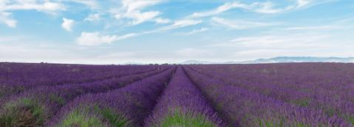
Bulgaria: Pure Bulgarian Lavender

Slide 12
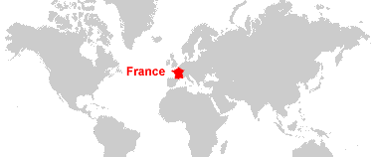
France

Slide 13
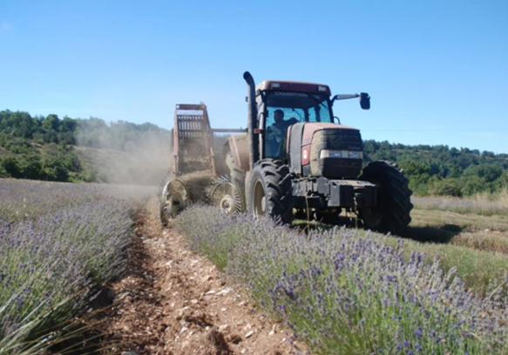
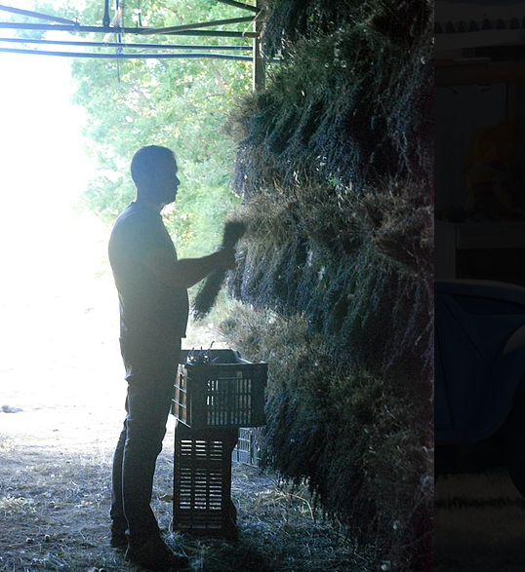
France- Les Grandes Pourraches
Photo: Johann Vervin

Slide 14
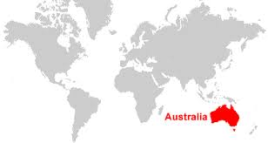
Australia

Slide 15
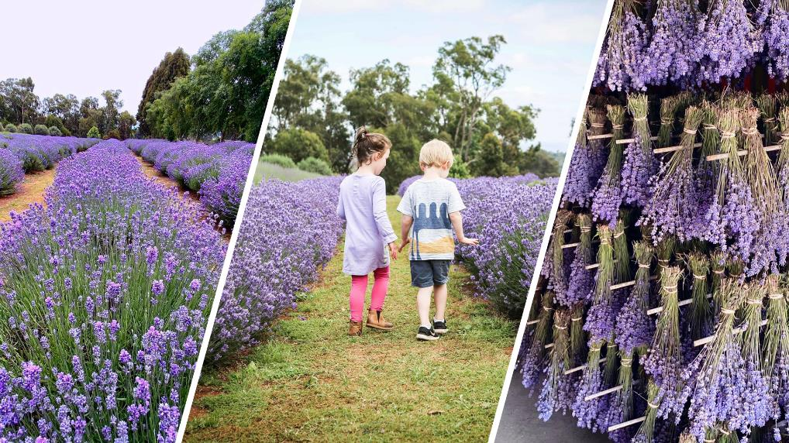
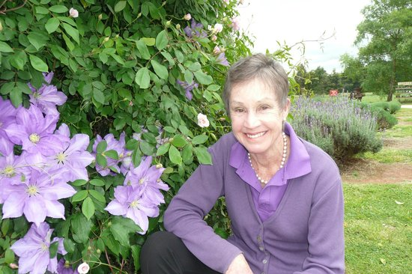
Australia- Warrantina Lavender Farm

