Slide 1
Bioreactors
Enhancing denitrification processes.

Slide 2
What is a bioreactor?
https://youtu.be/pQKtbDFd4A0

Slide 3
Where are they located?

Slide 4
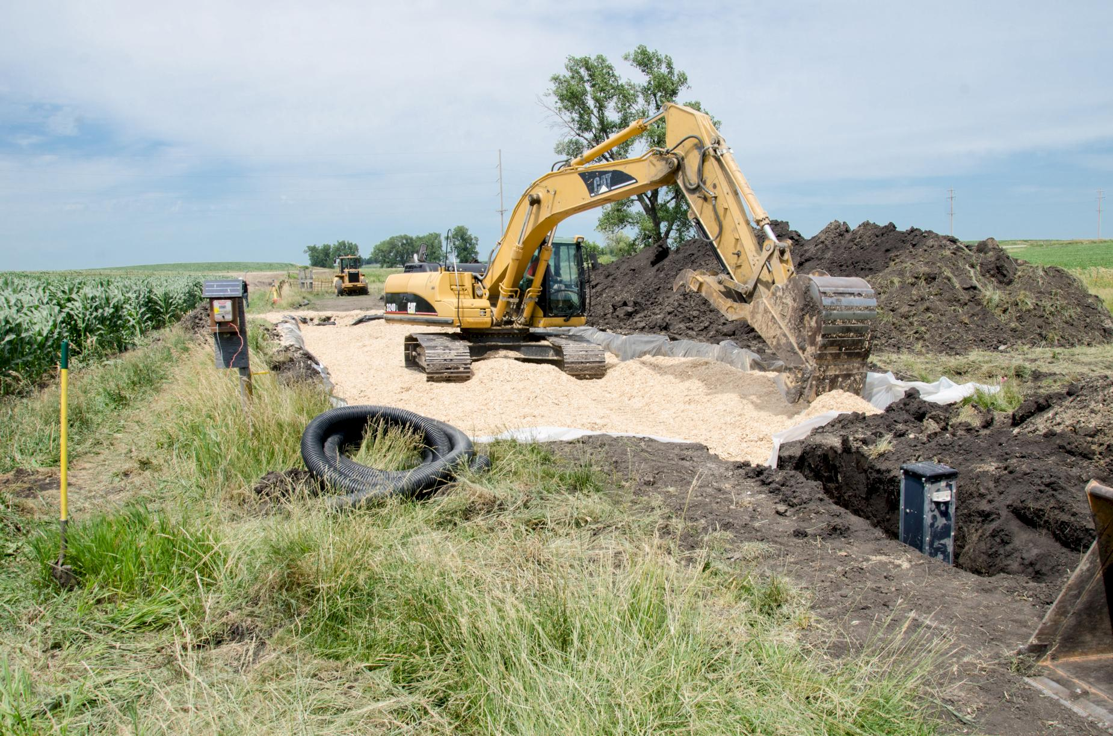
Where are they located?
Where is the watershed located? (Name of the watershed and approximate location in relation to cities, rivers, counties, or other landmarks)
Existing bioreactors?
Planned bioreactors?
Timeline of bioreactor installations?
Approximate costs of bioreactor installations?
Key partners?
Photo courtesy of the Iowa Agriculture Water Alliance and the Iowa Soybean Association

Slide 5
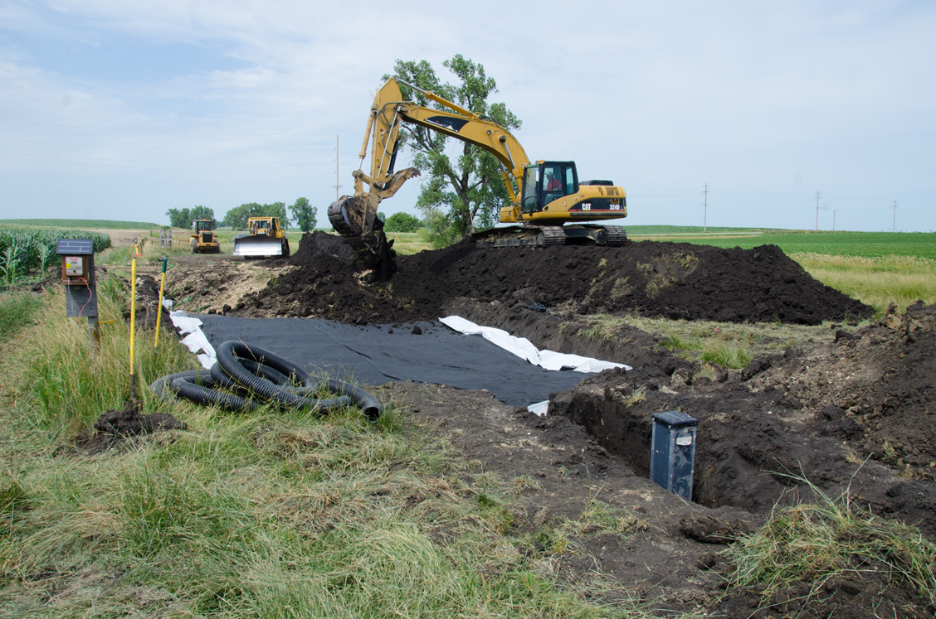
Bioreactor
Bioreactors – oldest 1995
100ft long and 10-30 feet wide
They can drain 20-80 acres
Nitrate reduction is 15-60%
Wood chips may need to be replaced (height of bioreactor will decrease as bacteria eat the wood chips).
Life span is 15-20 years
Photo courtesy of the Iowa Agriculture Water Alliance and the Iowa Soybean Association

Slide 6
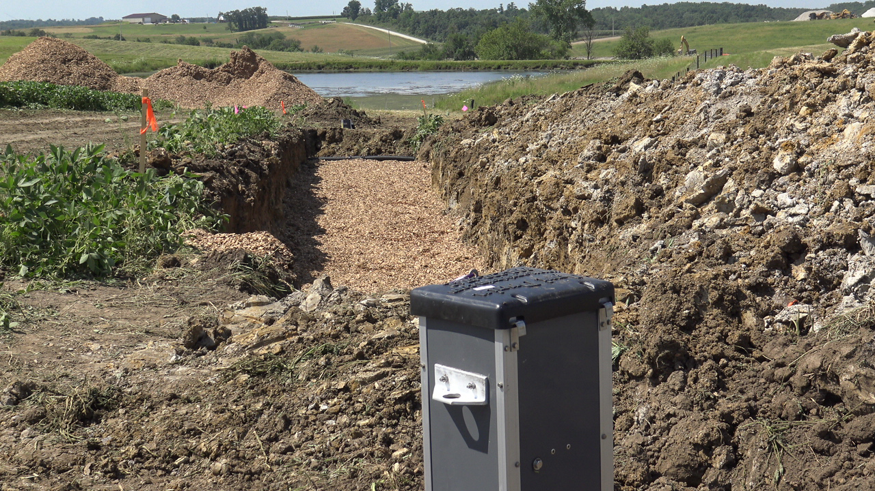
Bioreactor – how they work
Route field drainage water through a buried trench filled with woodchips
Bacteria convert nitrate (NO₃-) to atmospheric nitrogen gas (N₂)
Bacteria called denitrifiers
Bacteria breathe nitrate in and breath nitrogen out
Bacteria eat the organic matter – in many cases woodchips
Bacteria are anaerobic (they don’t need oxygen)
Control structures regulate water inflow and outflow
Photo courtesy of the Iowa Agriculture Water Alliance and the Iowa Soybean Association

Slide 7
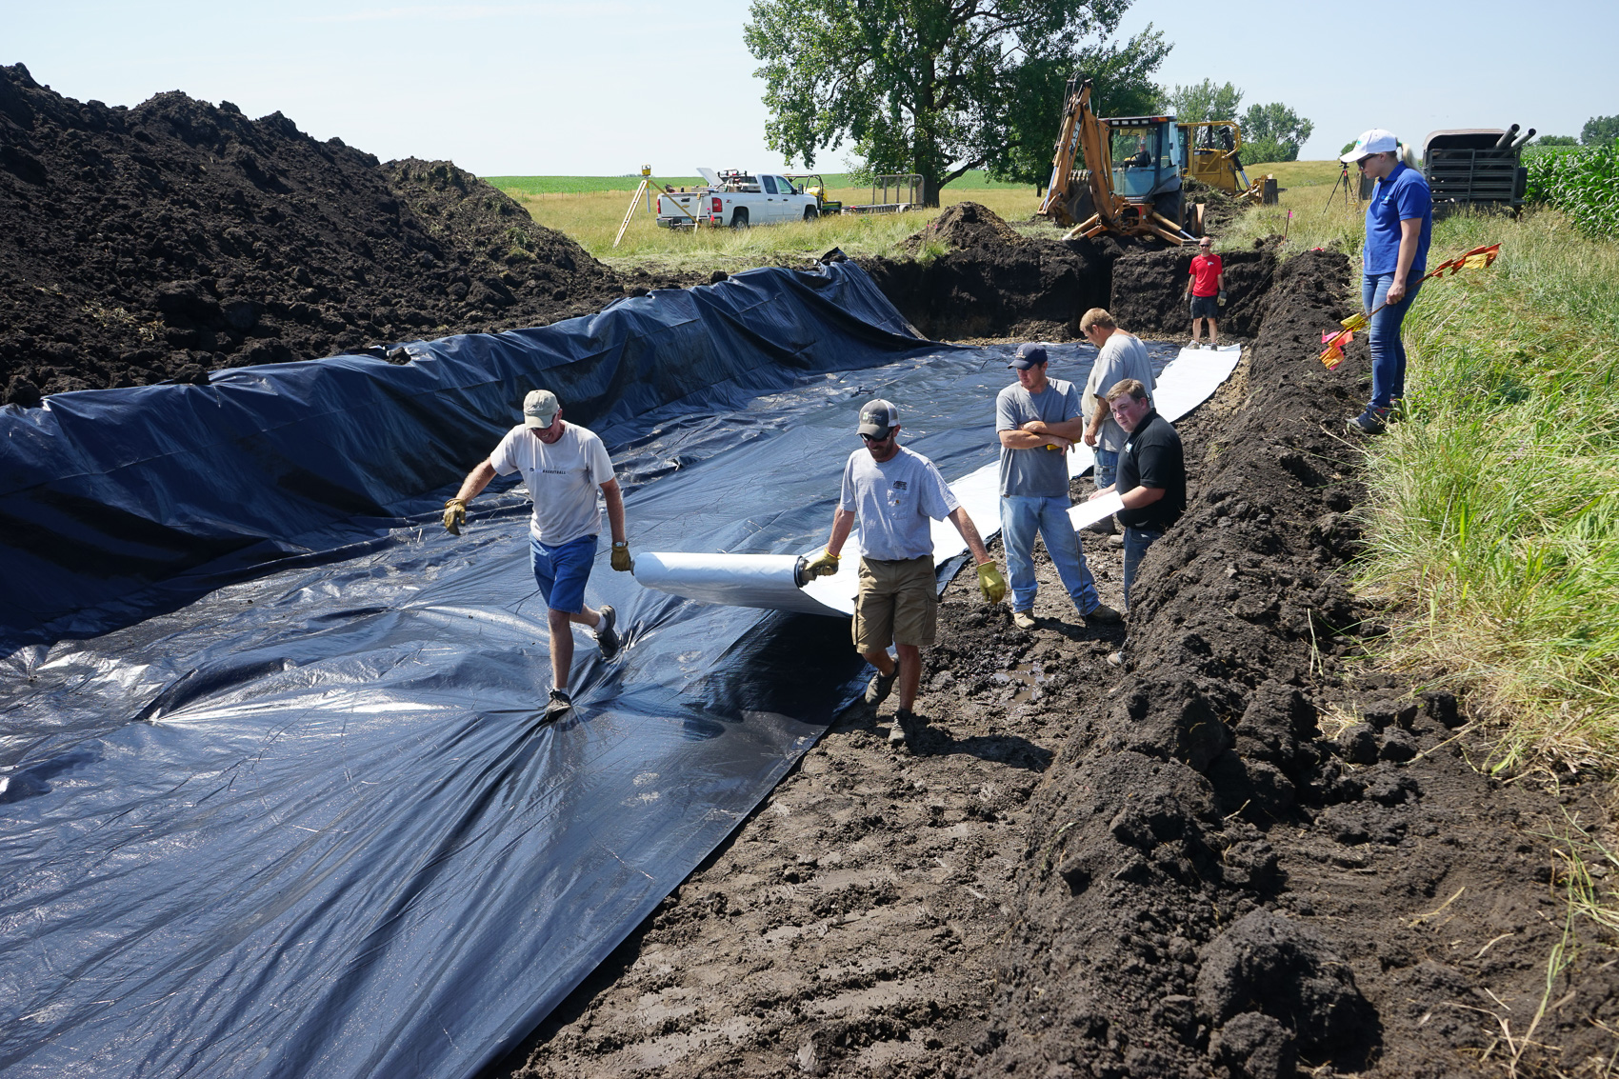
Bioreactors
As of 2016, there are 60 bioreactors in Iowa
It is estimated that farmers in Iowa need to install 120,000 to 180,000 bioreactors
Photo courtesy of the Iowa Agriculture Water Alliance and the Iowa Soybean Association

