Slide 1
Agriculture and Energy
Lesson 1

Slide 2

Agriculture and Energy
  U.S. farm production has become increasingly mechanized and requires timely energy supplies at specific stages of the production cycle.
  Agriculture spends about $30 billion a year on energy, which is 15% of total production costs.
  Unexpected price jumps or energy supply disruptions can easily negatively impact farm revenues.
  With agriculture’s large energy inputs, food prices are directly affected by fuel prices. High Oil Prices = High Food Prices

Slide 3
Types of Energy Use in Agriculture
  Direct Energy (~5% of expenses)
    Diesel: tractor field work, irrigation, grain drying
    Gasoline: smaller vehicles and older equipment
    LP & Natural Gas: grain drying, space and water heating
    Electricity: building and equipment operations, grain drying, irrigation
  Indirect Energy (~10% of expenses):
    Commercial nitrogen fertilizer is made from methane in natural gas
    About 5½ gallons of fossil fuels go into fertilizing one acre of soil
    Synthetic pesticides are made from energy-intensive chemical processing

Slide 4
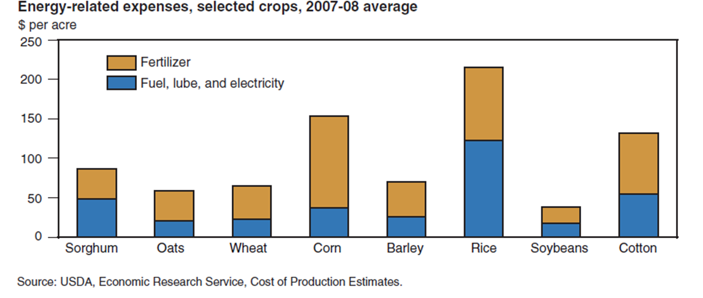
Corn and rice have high energy-related costs, soybeans have low costs

Slide 5
Examples of Energy Use
Grain Drying: Farmers use a significant amount of energy to dry crops, such as grain, tobacco, and peanuts.
Several types of energy can be used for crop drying, including LP gas, electricity, diesel fuel and natural gas.
Annual rainfall can have a significant effect on the amount of energy used to dry crops from year to year.
For example, above-average rainfall, especially just prior to harvest time, can increase the moisture level of grain. In order to meet quality standards it may require more energy to dry the grain.

Slide 6
Examples of Energy Use
Livestock:
Weather can also affect the energy used in livestock facilities and other farm buildings that use various forms of energy for heating, cooling, and air circulation.
Natural gas is commonly used to control greenhouse temperatures and dairies rely heavily on electricity to power milking machines and other equipment.

Slide 7
Examples of Energy Use
Irrigation: While many irrigation systems in the U.S. are gravity flow systems that require little or no energy for water distribution, irrigation systems that use pumps to distribute water use energy.
Based on the 2003 USDA Farm and Ranch Irrigation Survey, about 43 million acres of U.S. farmland were irrigated with pumps powered by liquid fuels, natural gas and electricity, costing a total of $1.55 billion (USDA NASS 2004).
Electricity was the principal power source for these pumps, costing $953 million to irrigate 24.1 million acres at an average cost of $39.50 per acre.
Diesel fuel was used to power pumps on about 12 million acres and natural gas was used on about 5 million acres (USDA NASS 2004).

Slide 8
Productivity has increase 350% since 1970
Energy efficiency began to improve when farmers began switching from gasoline equipment to more efficient diesel engines and began minimum tillage practices.
Since then, more efficient machines and processes have been introduced thanks to advanced technology.
Changes in the types of commodities produced have also led to these improvements.
The introduction of GMO seed has also been attributed to a reduction of on-farm energy inputs.

Slide 9
Benefits of using energy to increase agriculture production
  Energy use has allowed for fewer humans doing the work. Producers pay less in wages but more for electricity and fuel.
  Energy used by the US food system accounted for _____% of the increase in American energy use between 1997 and 2002.
  Food system energy use increased by ____% while total energy use rose by just 3.3%.
  Between 1996 and 2006 farm labor use fell by nearly ____%, while farm equipment use increased by 10%.

Slide 10
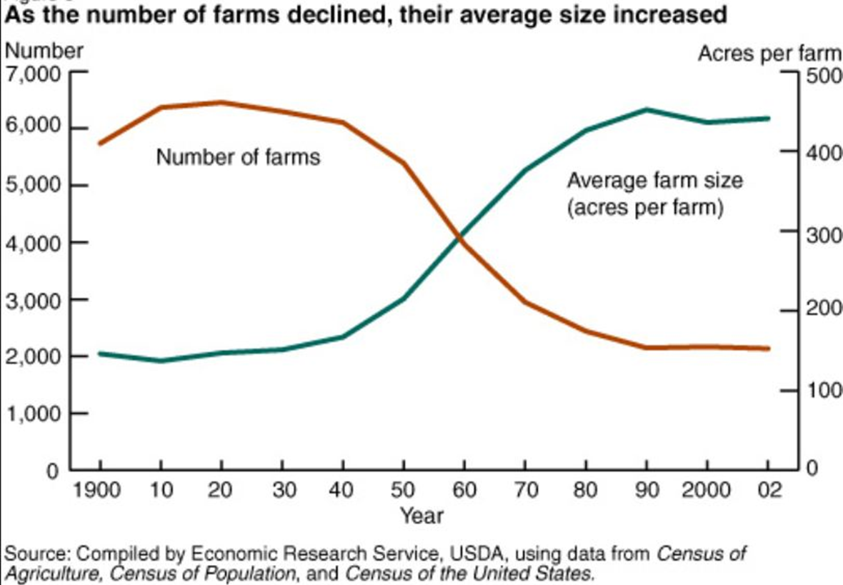
Benefits of using energy to increase agriculture production
  Commercial farms are using larger machinery, greater mechanization, and higher amounts of nitrogen fertilizers made from methane/natural gas.

Slide 11
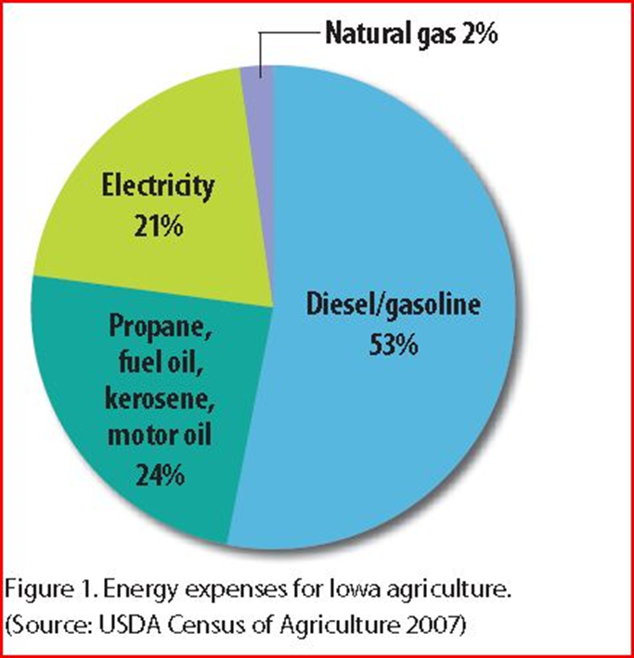
Using energy to increase agriculture production
  Iowa farmers spend nearly ____ billion dollars a year on energy for crop and livestock production and look for ways to save in these expenses

Slide 12
Sustainable Farming Practices
  Being less affected by volatile energy prices is mostly attained through efficiency measures associated with petroleum driven machines. For example, variable-rate technologies (i.e., precision planting & customized N/P/K application) reduces diesel use by tractors and natural gas used in the production of fertilizers (often manufactured overseas).
  Protection of natural resources vital for farming is a direct effect of less fossil fuel use and its associated pollutants. Clean air, water and soil are essential for productive and sustainable farming.

Slide 13
Energy Conservation & Efficiency
  Reduced Costs and Increased profits are attained by lower fuel and energy bills, realized by less energy consumption.
  Improved processes & productivity are attained through more reliable and efficient equipment that are generally associated with fine-tuning and upgrading equipment for efficiency. For instance, studies have shown higher worker productivity and safety when dairy barns are lit with brighter high-efficiency lights, this is also an example of increased profits.

Slide 14
On-Farm Renewable Energy Production
  On-farm energy conservation and efficiency measures could save up to $1 billion a year.
  Farms have great potential to generate renewable energy with their abundant natural resources.
    Solar power
    Wind power
    Hydroelectric
    Biomass fuels
    Biogas
    Geothermal

