Slide 1

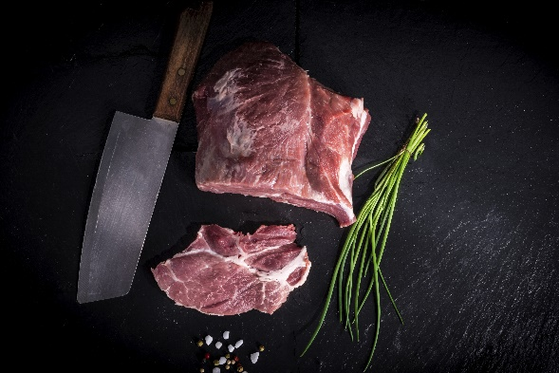
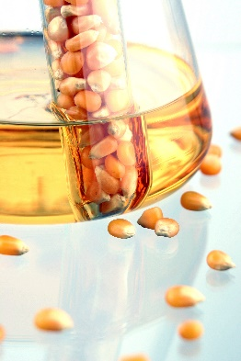
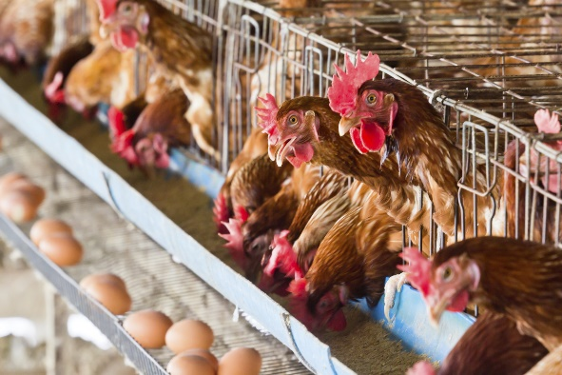
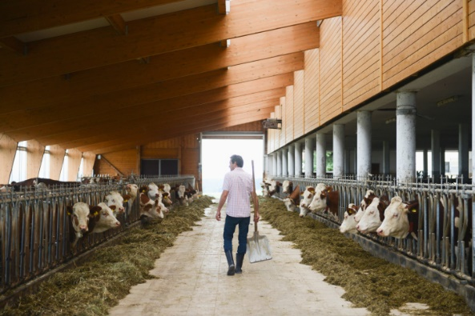
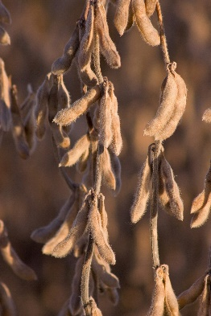
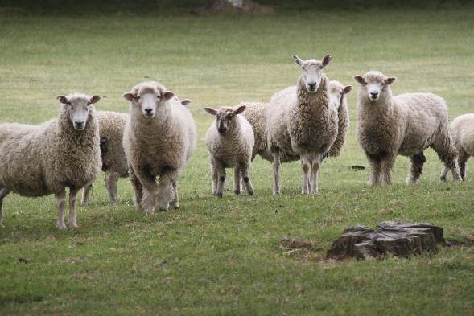
Educating Iowans with a focus on youth regarding the breadth and global significance of agriculture.
Who Am I?
Agriculture By-Products Edition

Slide 2
Your Challenge
In your groups, solve the riddles on the following slides using the poster handouts. You must name the agricultural source and the by-product itself.
Be the first team to hit the buzzer on your table and answer the question correctly.
If that team answers incorrectly, the opportunity goes to the team that hit their buzzer second, or the team to the left of them.

Slide 3
Practice Round
Riddle: I’m red when raw and brown when cooked. Cover me with cheese, lettuce, onion and a bun, and I’ve got the perfect look! I’m a by-product of ____. What am I?
Answer: Cattle, hamburger

Slide 4
I’m a by-product of ____, and I’m very sweet. I make a great July treat, and can be found in many different flavors. What am I?
Answer: corn, ice cream

Slide 5
I’m a by-product of ______, and you use me to keep cuts and scrapes clean. Once you stick me on, I’ll help you heal! What am I?
Answer: cattle, bandages

Slide 6
I’m a by-product of ______, and you may have used me this morning. I’m good at untangling knots. What am I?
Answer: pigs, brushes

Slide 7
I’m a by-product of _______, and if you want a good night’s sleep, you need me! I’ll keep you warm and comfy. What am I?
Answer: poultry, bedding & pillows

Slide 8
I’m a by-product of _______, and I’m found on many school desks. If you want to take notes, you’re going to need me. What am I?
Answer: trees, paper

Slide 9
I’m a by-product of ______, and a sandwich just isn’t the same without me! I can also be found in deviled eggs and cole slaw. What am I?
Answer: soybeans, mayonnaise

Slide 10
I’m a by-product of ______, and I’m a type of soap, used to keep people clean. There’s only one place on your body you would want to use me, and that’s on your head! What am I?
Answer: sheep, shampoo

Slide 11
I’m a by-product of ______, and you might be surprised that humans aren’t the only ones that like to eat me! My pulp is a good source of energy for animals that need to grow big and strong. Who am I?
Answer: sugar beets, livestock feed.

Slide 12
I’m a by-product of ______, and if people don’t put me on, they stink. I come in all different scents to cover up yours – imagine life without me! What am I?
Answer: cattle, deodorant

Slide 13
I’m a by-product of ______, and speaking of stink, you need me to keep your breath in check. You can chew me all day, but try not to swallow! Who am I?
Answer: corn, chewing gum

Slide 14
I’m a by-product of ______, and I’m found on paper. Usually you can find me in the crossword puzzles and classified ads. Who am I?
Answer: soybeans, ink

Slide 15
I’m a by-product of _______, and I’m on the walls of your house. Without me, your home would sure be dull! Who am I?
Answer: soybeans, paint

Slide 16
I’m a by-product of ________, and I’m a huge help to farmers. Pesky bugs don’t stand a chance against me! Who am I?
Answer: corn, insecticides

Slide 17
I’m a by-product of _______, and I’ll light up your life. Just give me a flame and I’ll burn all night! Who am I?
Answer: pigs, candles

Slide 18
I’m a by-product of ______, and if you put a bow on me, I’ll sing! I’ve been making beautiful music for thousands of years. Who am I?
Answer: sheep, instrument strings

Slide 19
I’m a by-product of ______, and I keep things running. Without me, it would be hard to change the channel, call from a cell phone, or even use your buzzer. Sometimes, I’m rechargeable. Who am I?
Answer: corn, batteries

Slide 20
I’m a by-product of _______ and _______, and you can find me in many restaurants and kitchens. I’m most at home atop a bed of leafy greens vegetables. Who am I?
Answer: corn and soybeans, salad dressing

Slide 21
I’m a by-product of _______, and I can be found on many women’s faces. Who am I?
Answer: cattle, cosmetics

Slide 22
I’m a by-product of _______, and many people who don’t eat meat eat me instead. I often come in white squares. Who am I?
Answer: soybeans, tofu

Slide 23
I’m a by-product of _______, and without me, the world would be a dirty place! I’m used to fix messes and keep things clean and hygienic. Who am I?
Answer: corn, cleaners

