Slide 1
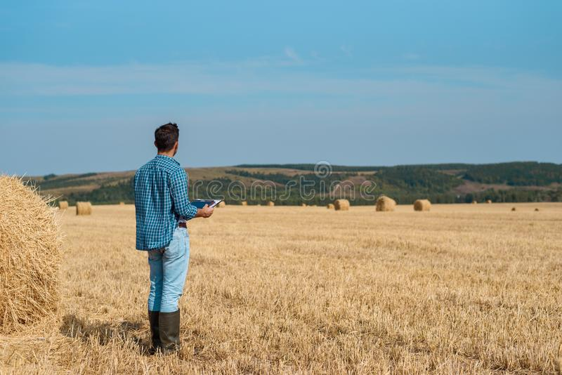
Calling all plant investigators!
Help Farmer Herb decide which type of lavender to grow!

Slide 2
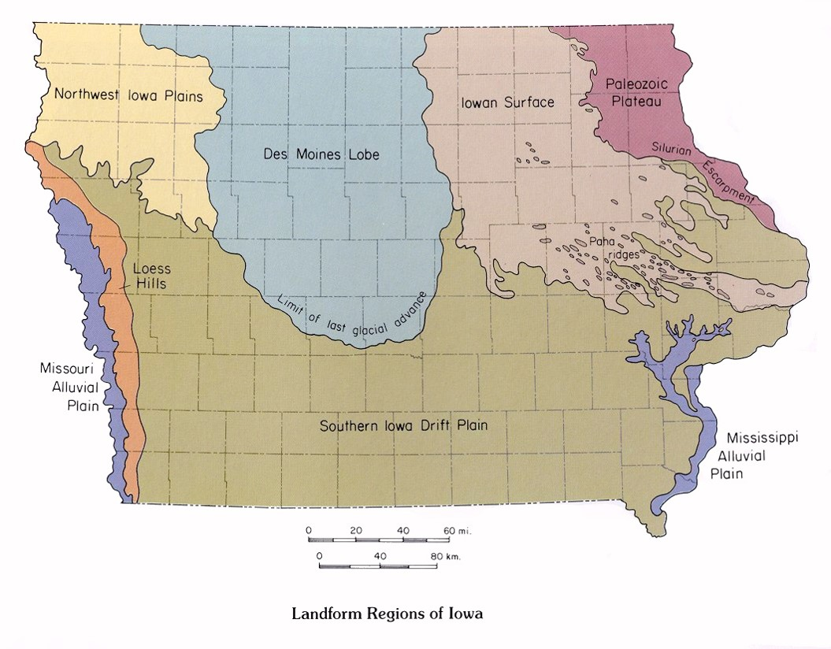
Farmer Herb’s Dilemma
Notes:
Plant investigators, Farmer Herb is in a pickle! He wants to grow lavender to use to make some yummy lavender cookies and some satchets of delightful smelling lavender! However, he doesn’t know what type of lavender to grow, and he really needs your help. He’s afraid he won’t grow the best variety for where he lives. His farm is in Western Iowa, in the Loess Hills region. Have any of you heard of the Loess Hills region? You can see the Loess Hills region in orange on the Iowa map and Farmer Herb’s farm is marked with a yellow star!

Slide 3
Let’s set the scene
Notes:
Plant investigators, we need to set the scene. The Loess Hills are rolling hills in Eastern Iowa. The hills are made up of material that is gritty, lightweight, and porous. What do you think those words mean? Loess means “loose” in German. The material is great for growing agricultural products, like lavender! The slopes of the hills make for very well-drained soil. The climate is like the rest of Iowa, with very cold winters and very hot summers.

Slide 4
Let’s meet some lavender!

Slide 5
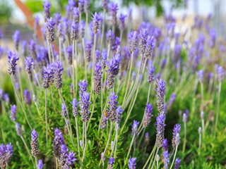
Lavender Type 1: French Lavender
Needs well drained soil
Originated in the Mediterranean
Thrives in the sunlight
Not very hardy, and won’t tolerate the cold well
Hardiness zones: 8-11
Notes:
French lavender is up first! Can one of my students who completed their project on French Lavender read the slide?
(Talk about the Mediterranean- an area with warm, dry summers and cool, dry winters. )

Slide 6
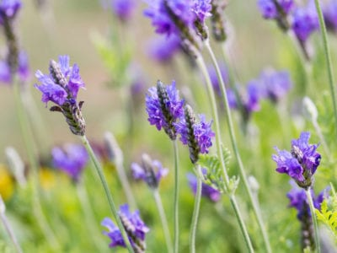
Lavender Type 2: Fern Leaf Lavender
Also native to the Mediterranean
In the United States, it grows best in areas like hotter parts of California
Needs dry and warm conditions.
It will not survive cold winters!
Needs well-drained soil!
Hardiness zones: 8-14
Notes:
Next up is Fern Leaf Lavender. Can one of my students who completed their poster on fern leaf lavender read this slide?

Slide 7
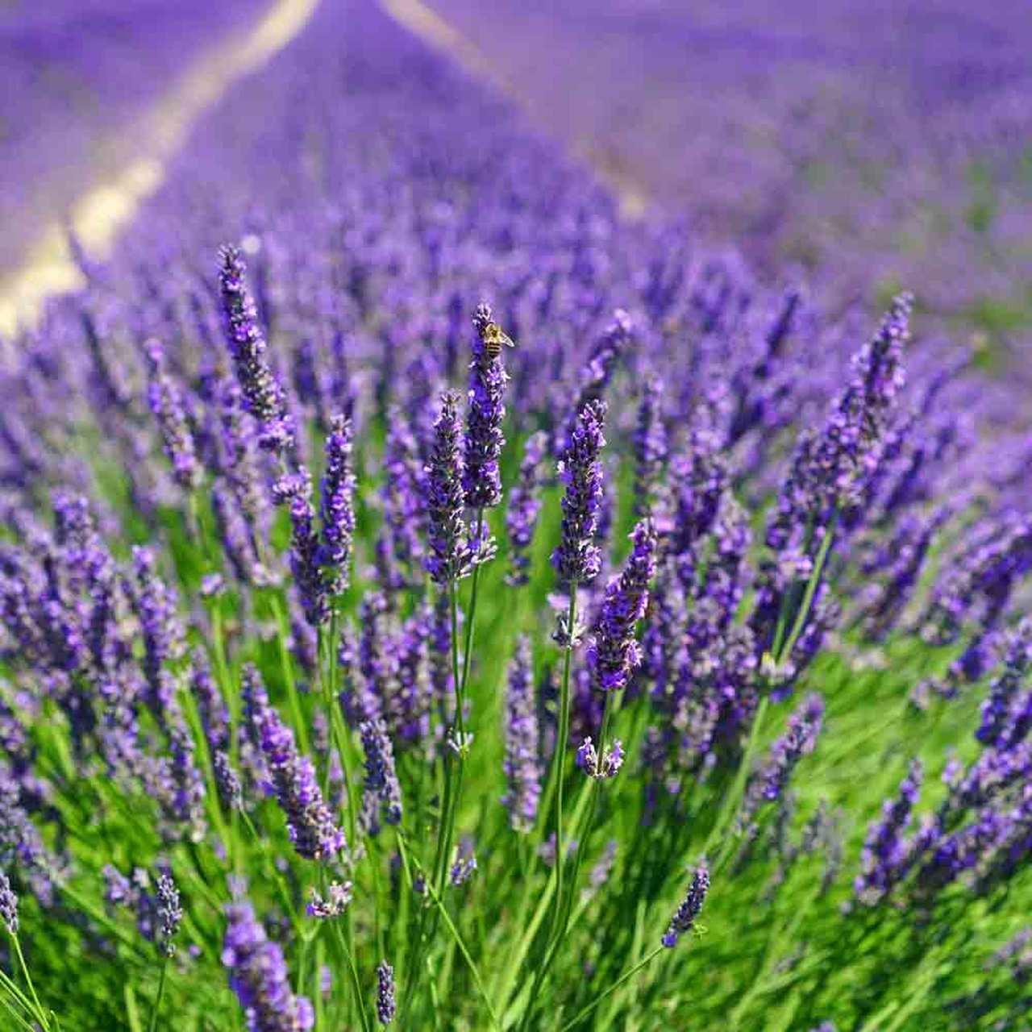
Lavender Type 3: English Lavender
Is a very hardy plant and can withstand rough conditions
Needs well drained, sandy soils
Should be grown in an area with a lot of sun
They are drought tolerant
Do not do well in humid climates
Hardiness zones: 5-8
Notes:
Next up is English lavender! Can someone from the English lavender group present this slide?

Slide 8
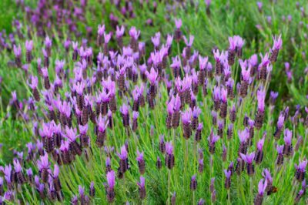
Lavender Type 4: Spanish Lavender
Thrives in hot weather
Needs well-drained soil
Does not do well in cold climates
Hardiness zones: 8-11
Notes:
Finally, we have Spanish lavender. Can someone from the Spanish lavender group present this slide?

Slide 9
Notes:
In your worksheets, you worked with Hardiness Zones. Before we decide what lavender Farmer Herb should grow, let’s take a look at what hardiness zones are! This is a map put out by the United States Department of Agriculture. This map can tell us where plants can survive based on temperatures. You each know what the hardiness zones of your lavender plants are, so let’s take a closer look at where the zones are.
*Point out that the colors grow warmer (from purple to yellow) from the Northern part of the United States to the Southern part, and that different plants survive well in some climates compared to others. Explain the key on the right side of the map. The Fahrenheit temperatures are on the right of the key and the Celsius temperatures are on the right.
Ask students if they know where Iowa is on the map, and if they can identify how many hardiness zones Iowa has, and which ones they are. Make sure to use the key and explain that the key is of the “Average Annual Extreme Minimum Temperature “ which helps determine how cold it is in each zone. Growers can use this map to decide which plants to grow according to where they live.
Ask students if they can think of any plants that would grow well in Florida, which has zones 9a-10b. (Some crops are citrus trees, sugarcane, and cotton)
Ask students if they think that citrus trees could also grow well in North Dakota. Why or why not? (North Dakota has zones 3 and 4, which are very cold. Citrus trees need a lot of sunlight and warmth.)
Ask students if they eat sweet corn during the summer. Sweet corn grows well in hardiness zones 4-8, so it can grow in a variety of places. Ask students to point out some states that sweet corn could grow according to hardiness zones.

Slide 10
What do you think?
Turn to a partner and discuss. Which type of lavender would grow best in the Loess Hills region and why?
Notes:
Alright plant investigators- which lavender type do you think will grow best in the Loess Hills region? Turn to a partner and discuss and then we will come back together and discuss!

Slide 11
Sources
https://encrypted-tbn0.gstatic.com/images?q=tbn%3AANd9GcT_pabScCtuWZ3FTomqlCbM5qnciukRiogUNg&usqp=CAU
https://media1.giphy.com/media/d7O6RdWEfvGJNtKowA/source.gif
https://www.iihr.uiowa.edu/igs/files/2017/06/LandMap1-2.jpg
https://www.google.com/url?sa=i&url=https%3A%2F%2Fwww.traveliowa.com%2Ftrails%2Floess-hills-national-scenic-byway%2F10%2F&psig=AOvVaw2tIiBPZ9ZnP7f8WMIlhfkG&ust=1602609253325000&source=images&cd=vfe&ved=0CAMQjB1qFwoTCLj_jvjGr-wCFQAAAAAdAAAAABAE
https://www.climatetypesforkids.com/mediterranean-climate
https://www.gardeningknowhow.com/wp-content/uploads/2020/02/fernleaf-lavender-400x300.jpg
https://cdn11.bigcommerce.com/s-q83qdckkjh/images/stencil/1280x1280/products/196/4042/English-LavendarBC__83996.1555970680.jpg?c=2?imbypass=on
https://www.gardendesign.com/pictures/images/320x240Exact/site_3/lavandula-dentate-french-lavender-garden-design_11717.jpg
https://planthardiness.ars.usda.gov/PHZMWeb/

