Slide 1
Educating Iowans with a focus on youth regarding the breadth and global significance of agriculture.
Renewable Energy and Agriculture
Energy for today & tomorrow

Slide 2
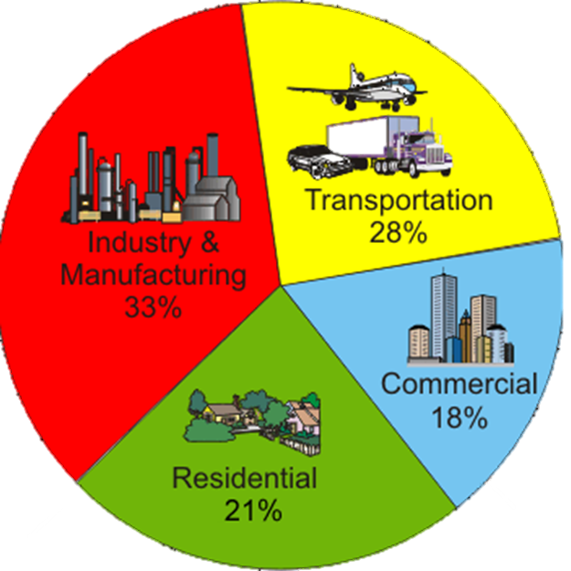
What is energy used for?
Heating
Cooling
Lighting
Transportation
Electricity
Can you name the two types of energy?
Notes:
The two types of energy are renewable and non-renewable energy.

Slide 3
Non-renewable energy
A source of energy that cannot be replaced when used up.
Coal
Fossil Fuels
Nuclear Energy
Natural Gas
What are some pros and cons of non-renewable energy?
Notes:
Non-renewable energy cannot be replaced and is often fairly expensive. It can also lead to dependence on oil from foreign countries.

Slide 4
Renewable energy
A source of energy that can be replaced
Sun
Water
Wind
Geothermal Energy
Biomass
What are some pros and cons of renewable energy?
Notes:
Biomass examples could include corn, soybeans, corn stover (husks and stalks), or grasses.
Benefits of renewable energy can include supporting local and U.S. economies, being better for the environment, and supporting farmers.

Slide 5
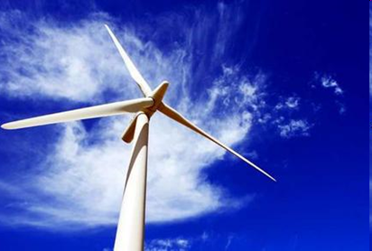
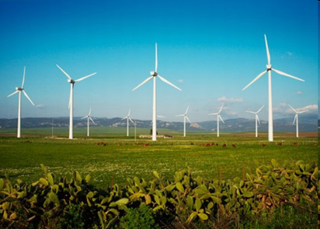
Wind Energy & Ag
Early uses of wind power include propelling boats, grinding grain, and pumping water.
Large wind turbines were first used in the U.S in the 1940’s and became c
Wind flows over the wind turbine blades causing lift. The blades are connected to a drive shaft that turns an electric generator to produce electricity.
A wind farm usually has dozens of wind machines scattered over a large area & can power over 220,000 homes per year!
Iowa is one of the nation’s leaders in wind energy.
Notes:
People have utilized wind energy since early recorded times. Wind propelled boats along the Nile River as early as 5,000 B.C., and helped Persians pump water and grind grain between 500 and 900 B.C.. For more information about the use of Wind energy through history, visit Wind-power http://www.energy.gov/eere/wind/history-wind-energy.
Learn more about wind energy today at: http://energy.gov/eere/wind/how-do-wind-turbines-work

Slide 6
Iowa and Wind Energy
This map shows the commercial wind farms in Iowa. What can you guess about Iowa’s geography, topography and climate based on the location of the wind farms?

Slide 7
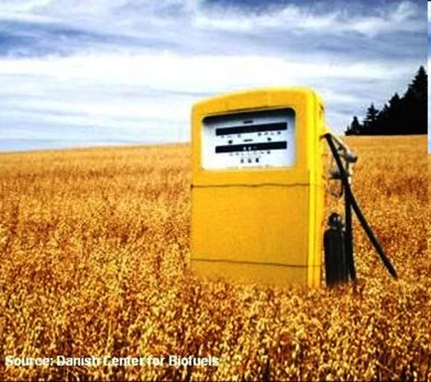
Biomass Energy (Biofuels)
Biofuels are transportation fuels that are made from biomass (organic matter) materials.
The two main types of biofuels are:
Biodiesel
Ethanol
Notes:
Biodiesel is a renewable fuel that can be used instead of diesel fuel. It can be made from vegetable oils, animal fats, or greases.
Ethanol is a clear, colorless fuel made from the sugars found in grains, such as corn, sorghum, and wheat, as well as potato skins, rice, and yard clippings.

Slide 8
Biodiesel
Biodiesel can be made from vegetable oils, including the oil from soybeans.
Biodiesel can be used instead of diesel fuel to power trucks and buses.
After soybeans are harvested in the fall and transported to biodiesel plants, the oil is combined with methanol to create a chemical reaction under heat and pressure. This process is repeated 2-3 times.
Iowa is in the top two states for soybean production and is the leader in biodiesel production.

Slide 9
Iowa and Soy Biodiesel
Why is Iowa a good place for producing biodiesel?
Notes:
Biodiesel plants are indicated by the letter “B” on this map.
Iowa is a great state for producing biodiesel because soybeans are grown throughout the state. Transportation costs are relatively low because there is not much distance between the biodiesel plant and where the soybeans are grown.

Slide 10
Ethanol
Ethanol can be made from the sugars found in many grains, but is mostly made from corn.
Ethanol is mixed with gasoline to power most cars. There are 10%, 15% and 85% ethanol mixtures sold in Iowa.
After corn is harvested in the fall and transported to ethanol plants, the starch is extracted and fermented. This creates ethanol.
Iowa is the #1 corn producing state and the #1 ethanol producing state.

Slide 11
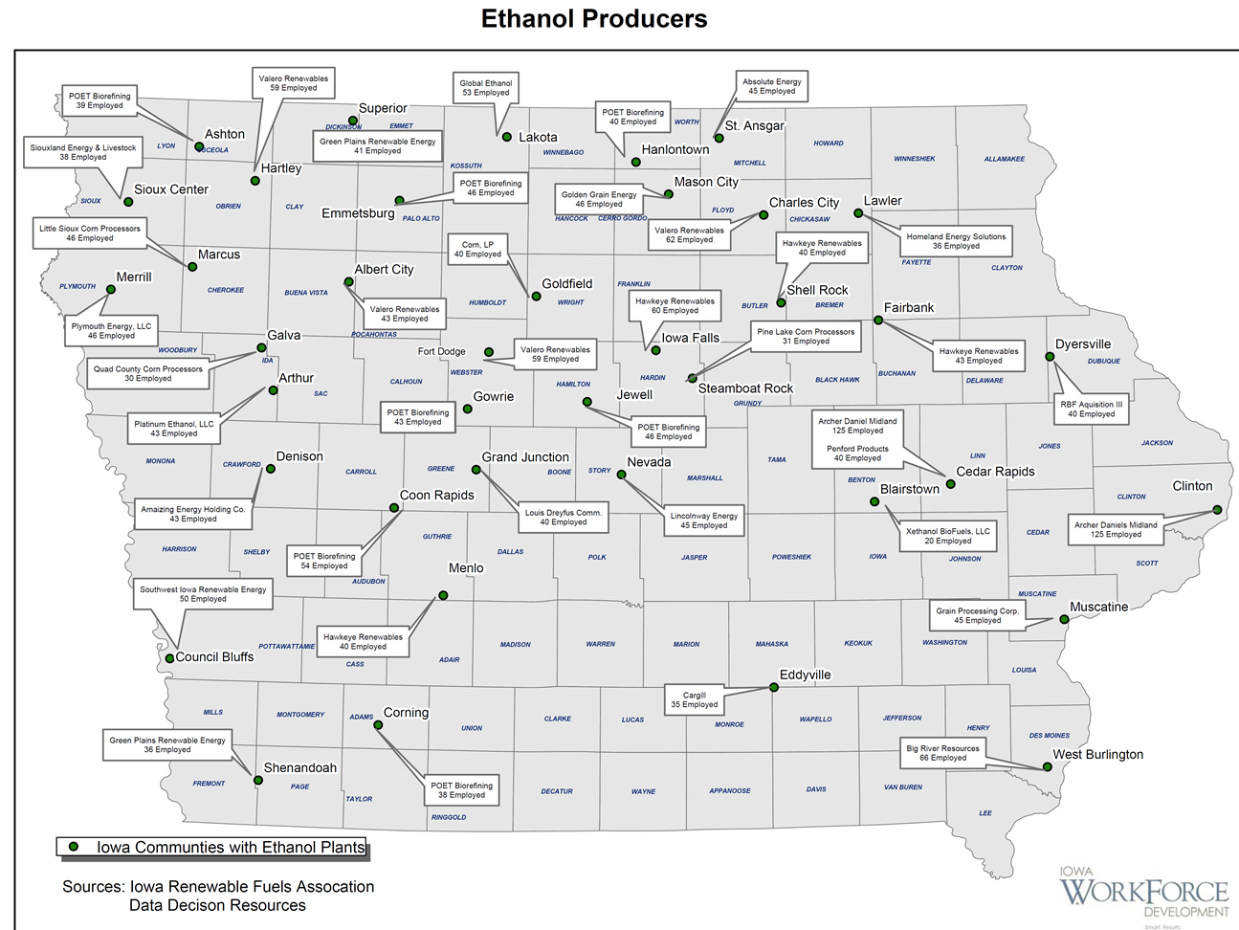
Iowa and Ethanol
Why is Iowa a good place for producing ethanol?
Notes:
There are many ethanol plants in Iowa. Many Iowans make a living through the ethanol industry.
Iowa is a great state for producing ethanol because we grow so much corn. The costs of transporting the grain are lower when there is less distance to travel. Being America’s largest corn producing state also makes Iowa a great place to produce ethanol!

Slide 12
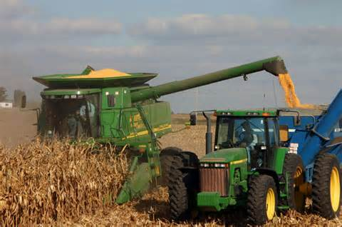
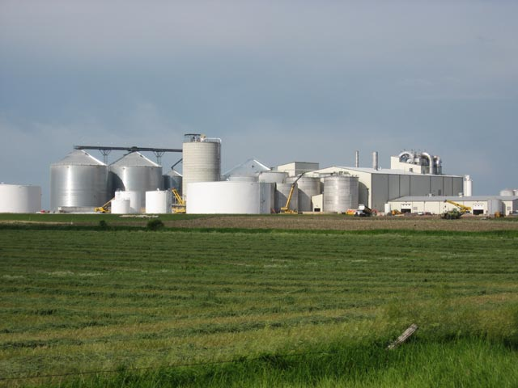
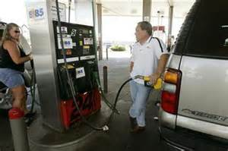
Tassel to Tank
Adapted from “Tassel to Tank”, Illinois Farm Bureau® Agriculture in the Classroom

Slide 13
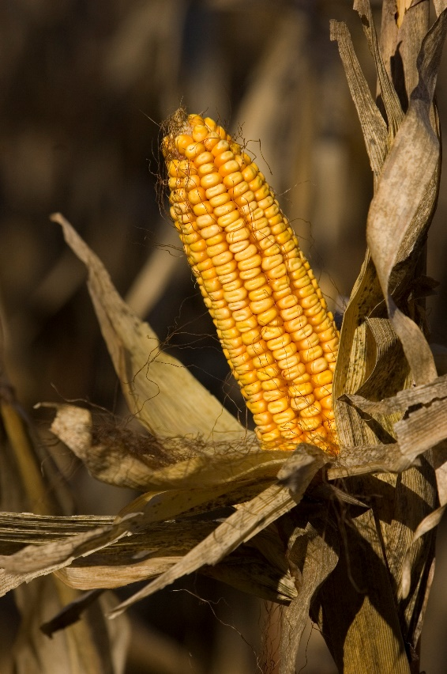
Tassel to Tank
Many Midwestern farmers raise field corn.
Field corn is planted in the spring and harvested in the fall.
While corn is growing, farmers have to protect it from weeds, insects and diseases.
Farmers use equipment like tractors, planters and combines that are expensive but necessary for efficiency.
Notes:
Field, or dent, corn is used to make ethanol because it is higher in starch than any other type of corn. Field corn is typically used for ethanol, high fructose corn syrup or livestock feed. Sweet corn is the type of corn that is eaten off the cob, and is harvested in the summer, rather than the fall. Sweet corn doesn’t have enough starch to make ethanol.
Farmers use cultivation to control weeds, crop rotation to control weeds, insects and diseases, and can use chemical sprays to control weeds, insects and diseases. These are called herbicides, insecticides and fungicides.
Tractors are used on farms to pull other equipment, such as grain carts, tillage equipment or even mowers. Planters are also pulled behind tractors, and they create a divot in the soil, drop the seed, and cover it. Combines are used to harvest crops, and they separate the ear from the stalk, the husks from the ear, and the kernels from the ear. The corn crop is collected in the combine, and the husks, stalks and cobs exit through the back of the combine and make great organic matter with nutrients for the following year’s crop to grow.
There are some great benefits to using combines and other large equipment in farming. For example, a farmer can farm a lot more acres of corn by his or herself if he has a planter that can plant 24 rows at a time, or harvest eight rows at a time. The equipment also does some of the tough jobs for farmers, so they don’t have to do as much work by hand.
These machines are very expensive, however, so there is a tradeoff for using them. Some machinery costs up to half a million dollars!

Slide 14
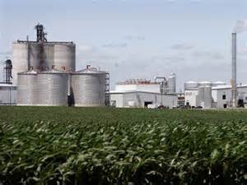
Tassel to Tank
After harvest, corn is transported in semi trucks to grain elevators that store and market the corn. They sell the corn to ethanol plants.
The corn is shipped to an ethanol plant, where the kernels are crushed and the corn starch is made into a powder in a grinder.
Water and enzymes are added to the corn to convert
the starch to glucose. This is called a mash.
The mash is cooked at a high temperature to kill bacteria.
Notes:
Corn is transported short distances in semi trucks. It can also be transported across states in trains or down rivers and across oceans in barges. Diesel trucks can run on biodiesel when hauling corn, but barges and rivers most often burn fossil fuels like coal.
Crushing the corn to expose the starch is very important. If the kernels weren’t crushed, the protective outer layers of the kernel, like the seed coat, would make it difficult to extract just the starch, which is the part of the kernel that is used to make ethanol.

Slide 15
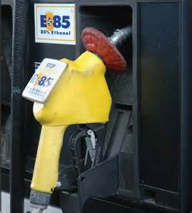
Tassel to Tank
Yeast is added to the corn.
The yeast converts the corn glucose to ethanol and carbon dioxide.
This is called fermentation, and usually takes 40-50 hours.
After fermentation, the pure ethanol is separated from the other fermentation products.
The ethanol is dehydrated in a molecular sieve, and then mixed with 5% gasoline for shipment to retailers.
Ethanol must be stored safely, because it is highly flammable.
The leftover fermentation products, or stillage, are dried and sold to livestock farmers as a nutritious feed source.
Notes:
Gasoline is mixed with the ethanol to make is undrinkable so that manufacturers don’t have to pay alcohol tax to transport it.
Ethanol must be stored away from any flames or sparks. In fact, workers at ethanol plants aren’t allowed to use cell phones in the plants because of the chance of them generating a spark. Ethanol is highly flammable, but less so than gasoline.
The leftover by-products of ethanol production are called Dried Distillers Grains, or DDGs, and can be fed to hogs, chickens and cattle.

Slide 16
Notes:
The ethanol production process. Note all the by-products of ethanol that are used!

Slide 17
How Stuff Works: Ethanol Video
http://www.discovery.com/tv-shows/other-shows/videos/how-stuff-works-ethanol/
Notes:
Video is 2 minutes, 59 seconds long. Link to Discovery Channel’s website.

